Slide 1
The Power of Oracy in the Mathematics Classroom
Building confidence and improving outcomes for our
Black African, Caribbean and Mixed Race students

Slide 2
Data Crunching
About 5 years ago I did a research action project on outcomes in Mathematics at KS4.
Analysis of our data showed Black African, Black Caribbean and particularly Mixed Race Black students were doing poorly in comparison to their peers. Especially boys.
Two years ago SMCS identified a significant problem with progression among Black African, Black Caribbean and Pakistani boys. It became a whole school focus.
In Maths, the disparity among Black students is more pronounced, with almost no-one pursuing the subject at Level 3.

Slide 3
Data for Mathematics shows a worrying pattern, with a marked skew towards lower grades among both Black African and Caribbean students.
The Normal Distribution and GCSE
The normal distribution is a natural phenomenon that occurs when you gather huge volumes of data – namely raw scores at GCSE – with small numbers of people at either end and the vast majority sitting in the middle.
Distributions of different ethnic cohorts within the main curve should – in theory – reflect the general trend. But they don’t.
U 1 2 3 4 5 6 7 8 9

Slide 4
Changing the Foundations
The problem starts much earlier than Key Stage 4, with patterns embedded by Year 9.
Year 7 Year 8 Year 9
WGD WA WT2 WT1 WGD WA WT2 WT1 WGD WA WT2 WT1 WGD WA WT2 WT1 WGD WA WT2 WT1 WGD WA WT2 WT1
BAFR and BCRB students
Students with Other Ethnicities
The implication of the final bar chart is that BAFR and BCRB students will be over represented in Foundation sets. This will preclude access to Level 3 courses and the opportunities afforded by studying Mathematics at a higher level.

Slide 5
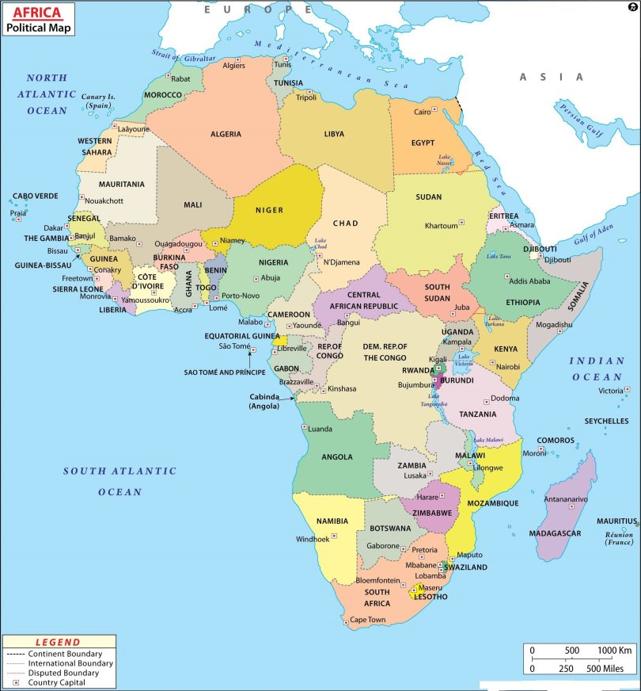
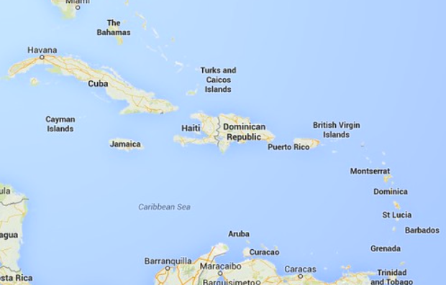
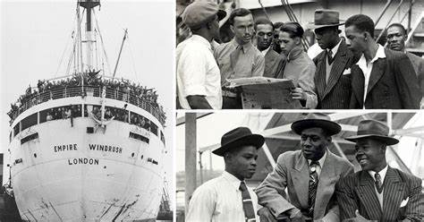
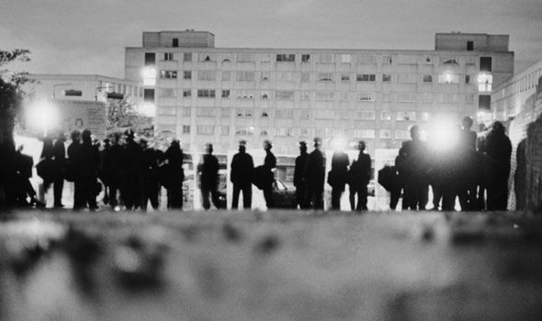
A Complex Picture
Different histories and family experiences impact on attitudes towards education.
Author of the recent controversial report on inequality, Professor Steve Strand, referred to the ‘immigrant paradigm’ (KAO and Thompson, 2003).
“(It) suggests that recent immigrants devote themselves more to education
than the native population because they lack financial capital and see
education as a way out of poverty.”
First or second
generation
Third or fourth
generation
However it is worth considering that families who descend from the Windrush generation experienced the racial discrimination that led to the race riots of the 1980s. These are the parents of our black and mixed race Caribbean students.

Slide 6
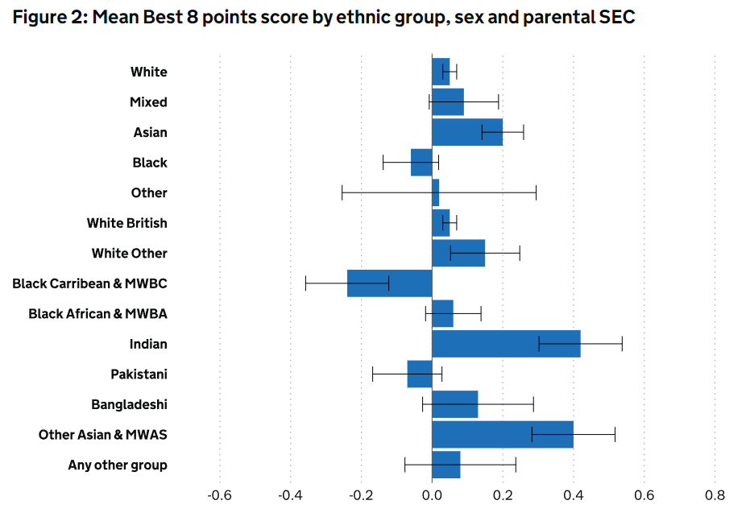
A National Problem
There is no single solution
There is no easy solution
But it is one where we can all make a difference
The groups with the lowest achievement at 16 years old are White British, and Black Caribbean and Mixed White and Black Caribbean students from low socio-economic status (SES) backgrounds, who have mean scores well below the average for all students.

Slide 7
By Considering Our Environment
In an article on young people from mixed race backgrounds, Dinah Morley states that
It is good to see posters from Black History Month program still present around school.
Our department displays celebrate Mathematical heroes from all sections of society.
Thereby proving you don’t have to be ancient or Greek to be good at Maths.
Where possible we should extend these to our own students participating in Maths.
“The experience of school has a huge impact on their personal development… Confidence building is important and it helps to move through an environment that makes you feel better, for example, where there are pictures of mixed race people.” (The Voice)

Slide 8
… and we can do more
We can highlight the origin of key concepts in our teaching, especially ones that have not originated in Europe or North America.
Did you know the place holder ‘zero’ was invented in India?
Most importantly, we need to make sure BAFR and BCRB students have an opportunity to contribute and answer questions in every lesson.
Hear their voices – participating in debate – in every lesson

Slide 9
Oracy Working Group
Led by Gemma McGuigan
Last term we focused on presentation
Rachel Bull fed back on a strategy she used in Science with Year 7s
Students created a poster and presented it to their peers
The students assessed each others’ presentations
They used a pro-forma to formalise their feedback
This is the idea that I pinched…
And I listened to the emphasis placed on Student Voice in the recent deep dive program

Slide 10
Translating into Mathematics
Identified upcoming topics
Students were taught the basics
Scaffolded worksheet of four questions
Students prepared two answers as homework
Students presented to their partner
Partner fed back using the pro-forma
Marking & Feedback
Outcomes were measured using the online skills test facility on Kerboodle
Student Voice response was garnered through an MS Teams survey
Ryan Crockford was particularly hot on how I could improve…

Slide 11
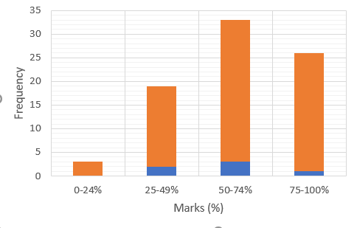
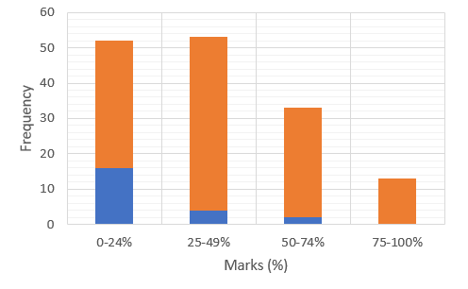
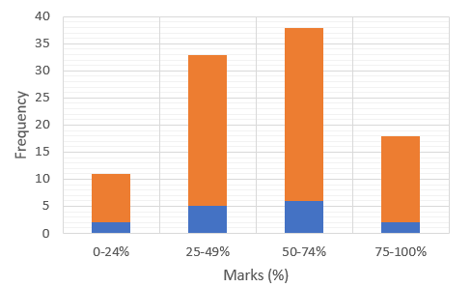
A Mixed Picture
Online Skills Test % Score Distributions
Year 7
Year 8
Year 9
Year 8 has a disappointing negative skew for all reflecting both the impact of the pandemic during transition from KS2 and disruption to learning during Autumn term. Contrast with Years 7 and 9, where there is a more normally distributed pattern, with few students doing poorly.

Slide 12
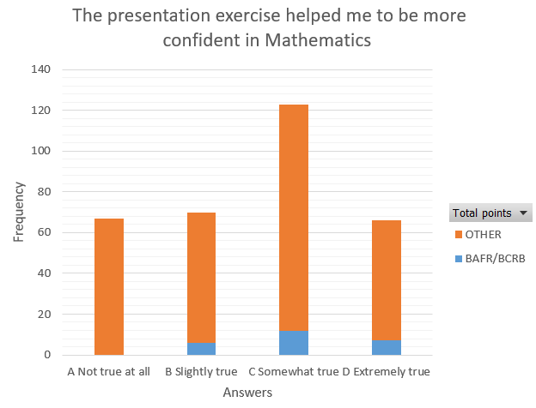
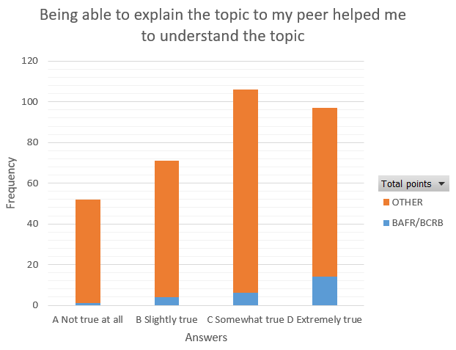

Sharing my work with my partner helped me understand how I had done things and maybe if I could have improved something if I had missed it out. (Year 8)
It helped me understand percentages a bit better when explaining it rather than just writing it. (Year 8)
… doing presentations helped me much more as I can explain in my own way how to solve the question and would love to do more... (Year 8)
The presentation exercise helped me to be more confident in Mathematics
BAFR/BCRB
Other
student Voice
Being able to explain my topic to my peer helped me to understand the topic
Not true at all Slightly true Somewhat true Extremely true
Answers
Not true at all Slightly true Somewhat true Extremely true
Answers

Slide 13
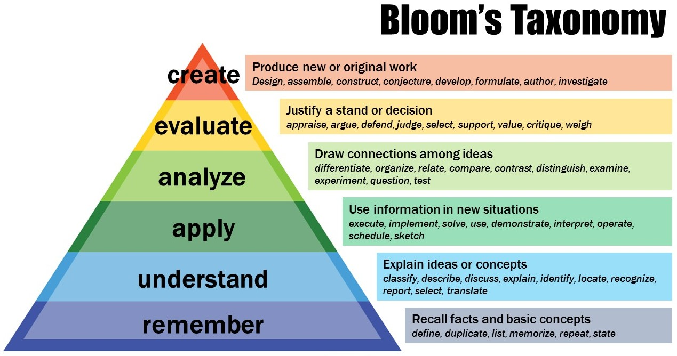
I liked doing this because it helped me understand the topic by going through the steps and explaining it to someone else. (Year 8)
It helped to make sure [that I] know what I am doing right and wrong and to understand the topic enough to explain it to my partner. (Year 9)
Very helpful Thank you! (Year 9)
Next Step:
Exploratory Talk
Teach

Slide 14


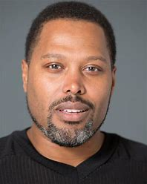
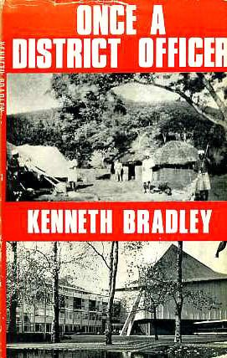
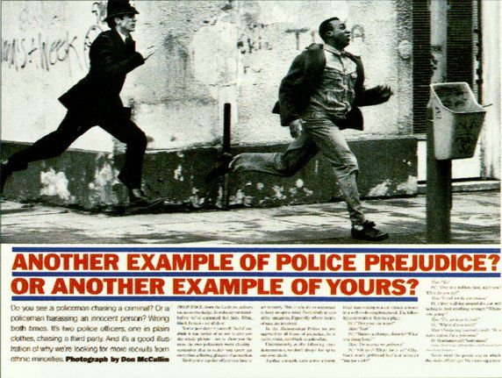
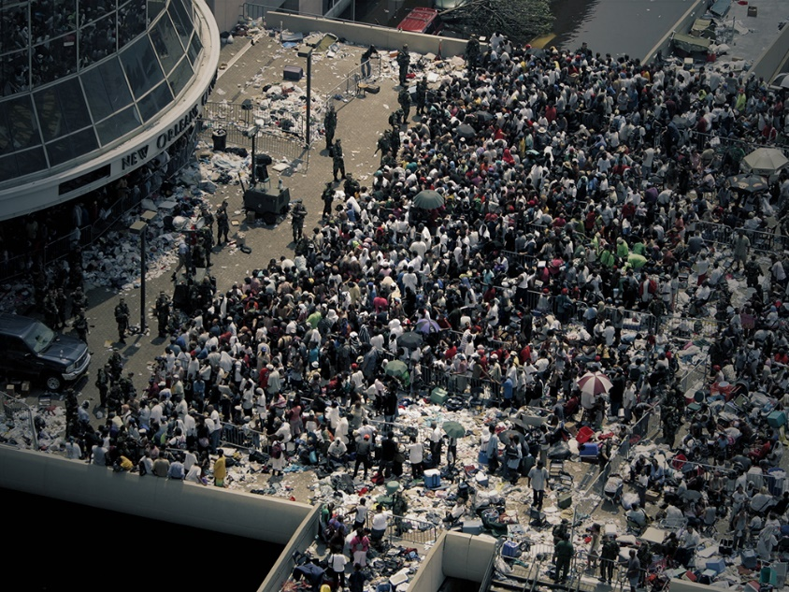
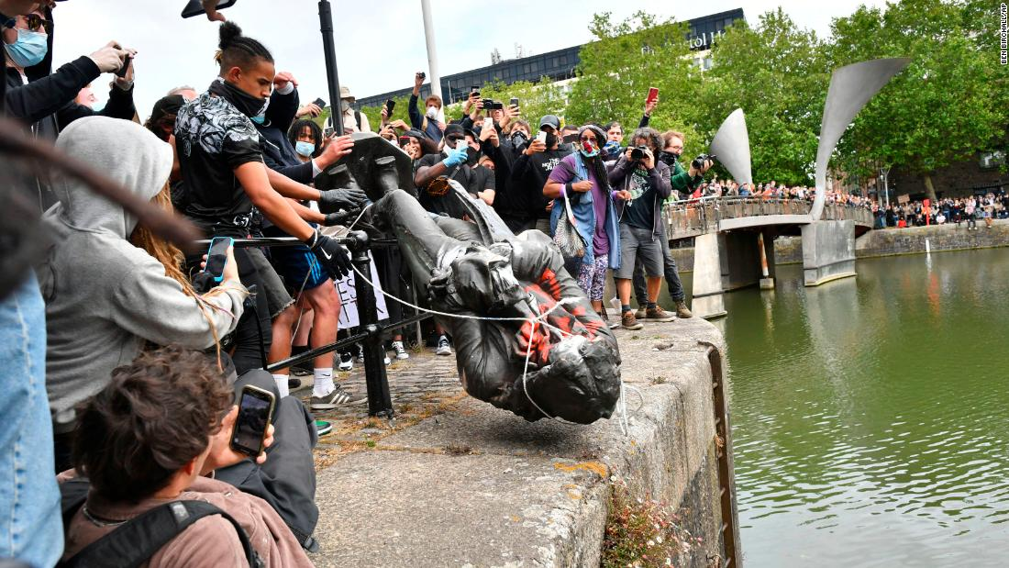
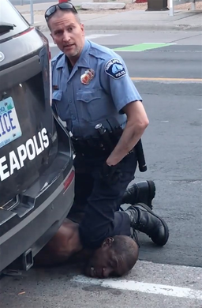
Changing My Perspective
Compelling explanation of white privilege that makes you think
Development of the black consciousness movement
Liberal self-satisfaction exploded by a trip to the supermarket
David Monteith

