Slide 1

Presentation at SERA Conference (23rd Nov 2023):
Primary school students using mathematics to argue collectively for social change
Dr Pete Wright
Senior Lecturer (Education & Society)
University of Dundee pwright002@dundee.ac.uk
@petewright0 www.mathsocialjustice.org

Slide 2
The research project
The Primary Maths & Social Justice research project was a collaboration between myself, two co-researchers (Caroline Hilton, UCL Institute of Education, and Joel Kelly, The Blue School) and six teacher researchers in two London primary schools.
The project aimed to explore ways of developing students’ socio-mathematical agency (SMA), defined as the ability to use mathematics effectively to argue collectively for social change.
(Wright, Hilton & Kelly, 2023)

Slide 3
Theoretical background
Why focus on developing socio-mathematical agency?
Calls (from UNESCO and others) for humanistic school curriculum that cultivates collective knowledge/critical understanding needed to address the environmental/economic/social challenges facing global society.
‘Powerful’ mathematical (and disciplinary) knowledge dependent on agency of knower.
Mathematical understanding essential for understanding/addressing real life problems.
Students neglect mathematical (and disciplinary) knowledge when tackling social justice issues.
(Wright, 2022)

Slide 4
Methodology/methods
Model of participatory action research aimed at building teachers’ agency/self-efficacy in developing practice (Wright, 2021; Wright, et al., 2022).
Research team drawing on teacher researchers’ and academic researchers’ complementary expertise/knowledge.
Series of research team meetings focusing on: discussing theory; agreeing research design; planning/evaluating two research lessons.
Interviews with teacher researchers at start/end of project – thematic analysis of interviews/evaluations.
Student survey designed collaboratively and implemented by teacher researchers – thematic analysis and statistical analysis.

Slide 5
Examples of classroom activities
Using counters for students/groups to vote on choice of ‘Golden Time’ activities and reflect on the ‘fairness’ of different voting methods used.
Discussing the fairness of London’s ULEZ charges which prompted collecting data on how students travelled to school and presenting results in tally chart/pictograph.
Devising a timetable on how to allocate time fairly to 6 classes for using a new play area during break and lunch times (only 5 days).

Slide 6
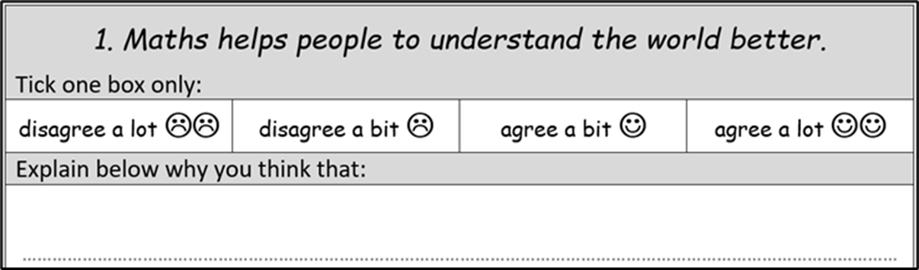
The survey
There were 6 survey items similar to this:
Other statements included:
2. It is good to solve maths problems with other people.
3. Maths can be used to make the world a better place.
4. You can do more in maths when you work with others.
5. Maths can be used to mislead people.
6. You can use maths to help you explain something.

Slide 7
Selected findings from surveys:
Aidan’s Year 2 class showed a significant increase in aspects of SMA over the course of the project.
Statistical analyses suggested a reasonable level of validity/reliability for survey (ignoring Question 5).
There was a significant (p < .05) increase in students’ rankings (with large effect size) on Statements 2, 3, 6 (using Wilcoxon Matched-Pairs Signed-Rank Test).
The thematic analysis of survey responses from Aidan’s class supported this finding (see next slide).
(Wright, Hilton & Kelly, 2023)

Slide 8
Statement 2: It is good to solve maths problems with other people.
Statement 3: Maths can be used to make the world a better place.
Statement 6: You can use maths to help you explain something.
 | Survey 1 Comment | Rank | Survey 2 comment | Rank
Student 13 | Because someone might give you the answers so it wouldn't be what you think - but peer marking is OK. | 2 | Then it helps you and each person can do a different method then work together. | 4
 | Survey 1 Comment | Rank | Survey 2 comment | Rank
Student 20 | I'm not sure. | 2 | Scientists can use maths to make solar cars. | 3
 | Survey 1 Comment | Rank | Survey 2 comment | Rank
Student 15 | It can help you explain a maths question. | 3 | If you're in a company and you explain how much things you need to make for the world, it's good - you could use a tally chart. | 4

Slide 9
Selected findings from interviews:
Students showing higher levels of engagement and taking greater ownership over their learning.
The children were very engaged. I think the fact that they were attributing it to a real-life problem or challenge. So, they really took ownership over setting their own investigations and then understood very much how maths can be related to real life … The taking ownership of it really helped their enthusiasm to the tasks.
(Layla, Year 6 teacher, Meeting 5)

Slide 10
Selected findings from interviews:
Students’ increasing appreciation of how maths is relevant/applicable to real life.
I think it's had a really positive impact on the students and in how their understanding of mathematics and the importance of mathematics, not just in the context of a maths lesson, but in the wider world.
(Aidan, Year 2 teacher, Interview 2)

Slide 11
Selected findings from interviews:
Students growing appreciation of how maths can be used to argue for change.
So, we, kind of, saw that, when they went off doing their independent task … the children had a better overview at the end and were able to feedback during the plenary, and actually give answers that had reasoning behind them, rather than just: “This is the answer and that's it.” … the children have more to say about social justice, or fairness, equality, doing the maths, where it made an impact on their own lives, in comparison to when we've looked at fairness, equality, all that, in previous tasks … they just don't have as much explanation with a reason.
(Emma, Year 1 teacher, Meeting 5)

Slide 12
Selected findings from interviews:
Students increasingly able to work collaboratively to solve problems.
… there was some really passionate debate and lots of really good, sensible kind of comments and examples being put forward by the children … And in the lesson that we taught, they were just really passionate about putting across their opinions as well, which is quite nice to see. … It was nice to see kind of the teamwork aspect of it work quite well.
(David, Year 2 teacher, Interview 2)

Slide 13
Concluding remarks
Participatory Action Research has the potential to transform classroom practice.
Focusing on students applying disciplinary knowledge to social justice issues can lead to significant increases in SMA.
Students become more enthusiastic in solving real-life maths problems when engaging with meaningful contexts.
Appropriate encouragement/support can help students develop their capacity to work collaboratively in using maths to argue for social change.
Such an approach can cultivate the collective disciplinary knowledge and critical understanding needed to address social/environmental/economic challenges facing society.

Slide 14
References
Wright, P., Hilton, C., & Kelly, J. (2023). Primary Maths and Social Justice research project report. https://mathsocialjustice.files.wordpress.com/2023/01/pmsj-report-jan23.pdf
Wright, P. (2022). Conceptualising and operationalising socio-mathematical agency. Proceedings of the Twelfth Congress of the European Society for Research in Mathematics Education (CERME12), February 2022, Bozen-Bolzano, Italy, pp. 1872-1881. https://hal.science/CERME12/hal-03747841v1
Wright, P., Carvalho, T. & Fejzo, A. (2022). Visible mathematics pedagogy: A model for transforming classroom practice. Educational Action Research, 30(2), pp. 168-191. https://doi.org/10.1080/09650792.2020.1850497
Wright, P. (2021). Transforming mathematics classroom practice through participatory action research. Journal of Mathematics Teacher Education, 24(2), pp. 155-177. https://doi.org/10.1007/s10857-019-09452-1
Notes:
The reference lists for these papers can be used as a source for the theories we draw on.

Slide 15
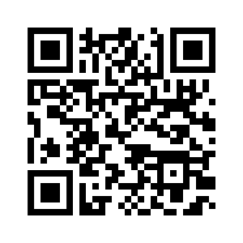
Primary Maths & Social Justice webpage
Download the ppt and find out more about the project at: https://mathsocialjustice.org/research/
Questions?
Notes:
The ppt will be uploaded to the TMSJN website on ‘Research’ page.

