Slide 1

Workshop 1: mathematical problem solving
Dr Pete Wright
Senior Lecturer (Education & Society)
University of Dundee
Scotland, United Kingdom
Contact:
pwright002@dundee.ac.uk
@petewright0
www.mathsocialjustice.org

Slide 2
What is mathematical problem-solving?
General consensus that problem solving is fundamental to mathematics curriculum.
However, lack of agreement over what is meant by ‘problem solving’ in mathematics.
Discuss:
What is a ‘problem solving’ in mathematics?
What is a mathematical ‘problem’? Give an example.
“A non-routine task, or problem, is ‘a task for which the solution method is not known in advance’ (NCTM, 2000, p.52).” (Foster, 2023, p.595).
How does this definition relate to your discussion?

Slide 3
why is mathematical problem-solving important?
General consensus that problem solving is fundamental to mathematics curriculum.
Discuss:
Why is ‘mathematical problem solving’ important?
Draft initial statement for revised Scottish mathematics curriculum (December 2024):
Purpose: to develop children and young people as mathematical thinkers - individuals who can use precise reasoning, critical analysis, and connected understanding to make informed decisions, solve problems, and appreciate the patterns and mathematical relationships that shape the world.
How does this statement relate to your discussion?

Slide 4
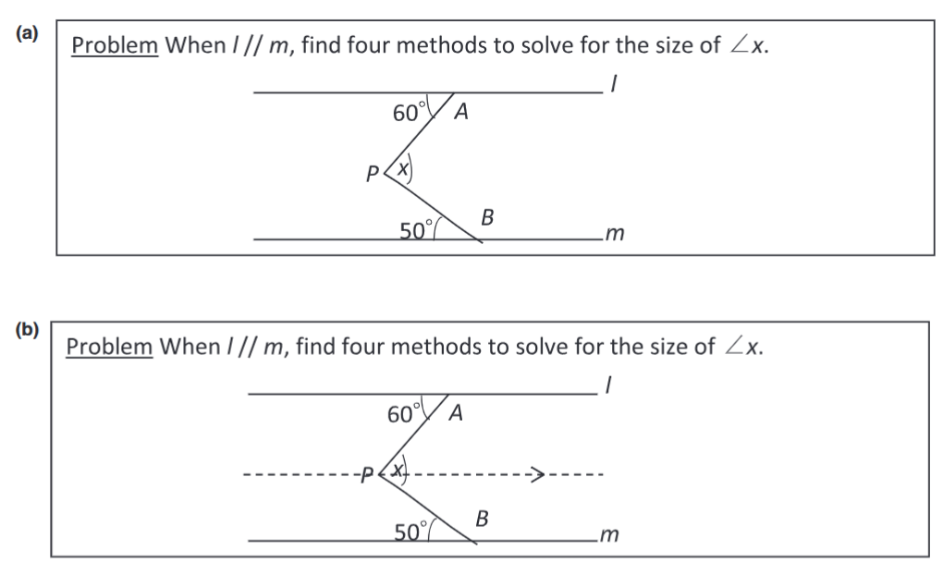
Frameworks for problem-solving in maths
Polya’s (1945) general framework that describes four problem-solving stages:
Understanding the problem
Devising a plan
Carrying out the plan.
Looking back.
Problem-solving heuristics used to represent, explore, solve problems :
Analogy, drawing figures or auxiliary constructions, special cases, etc.
See ‘explicit teaching of problem-solving tactics’ (Foster, 2023, p.603) for the use of ‘auxiliary lines’ in geometry problems.
How else could you solve the problem with an auxiliary line?

Slide 5
Frameworks for problem-solving in maths
Schoenfeld’s (1985) framework to explain and document students’ problem-solving behaviours:
The use of basic mathematical resources or knowledge base.
The use of cognitive or heuristic strategies.
The use of metacognitive or self-monitoring and control strategies.
Students’ beliefs about mathematics and problem-solving.
(NCTM, 2009) conceptualizes a ‘problem-solving approach’ as a way of fostering mathematical reasoning and sensemaking activities.
Phases:
Analyzing a problem or concept.
Implementing a strategy.
Looking for connections.
Reflecting on a solution.
Reasoning habits that students need to internalize and practice during the solution process: Finding key concepts, seeking for patterns, considering special cases, examining the meaning of procedures and operations, looking for connections, interpreting solutions, examining different problem-solving approaches, generalizing solutions, etc.

Slide 6
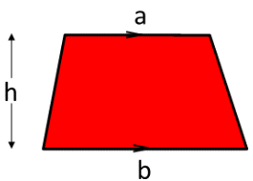
A problem-solving task
Explain to others why the area of a trapezium is ½h(a+b)
Use a trapezium made from A4 paper to help you explain.
Try and draw on a different conceptual representation to everybody else.
How would you write the formula?
Assume you know how to find the area of a rectangle, triangle, parallelogram.
Reflect on what makes this a problem-solving task.

Slide 7
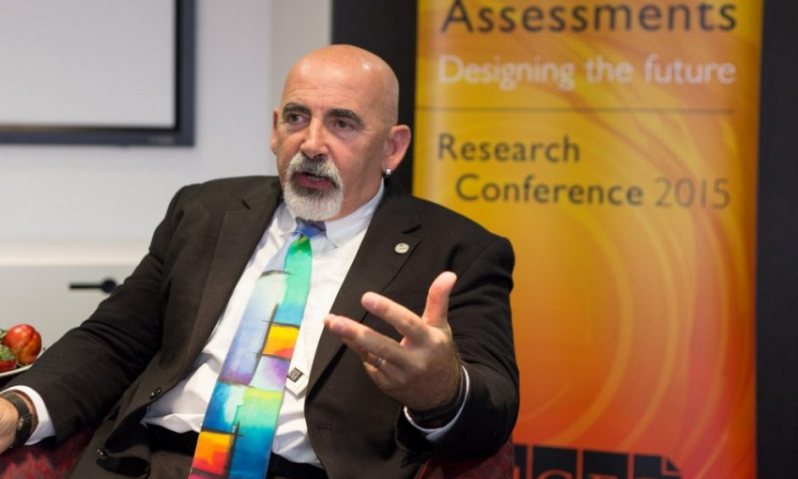
Problem-solving as inclusive pedagogy
Watch the 2½ mins video clip of Dylan William in conversation (from 13:17 to 15:42 only).
Reflect on how problem-solving approaches offer a way of developing inclusive pedagogies in mathematics.
Follow-up reading: Baldry, F., Mann, J., Horsman, R. et al. (2023). The use of carefully planned board work to support the productive discussion of multiple student responses in a Japanese problem-solving lesson.
https://doi.org/10.1007/s10857-021-09511-6
https://www.teachermagazine.com/au_en/articles/in-conversation-dylan-wiliam

Slide 8
Promoting the teaching of mathematical problem solving
“It has been a complaint for many decades that problem solving is not in practice as prominent within the school mathematics curriculum as it should be.” (Foster, 2033, p.595)
How does this reflect the situation in your own context?
Discuss why this might be the case.
How might it be addressed?

Slide 9
References
Baldry, F., Mann, J., Horsman, R. et al. The use of carefully planned board work to support the productive discussion of multiple student responses in a Japanese problem-solving lesson. Journal for Mathematics Teacher Education, 26 (2), 129–153 (2023). https://doi.org/10.1007/s10857-021-09511-6
Foster, C. (2023). Problem solving in the mathematics curriculum: From domain-general strategies to domain-specific tactics. The Curriculum Journal, 34(4), pp. 594-612.
https://doi-org.libezproxy.dundee.ac.uk/10.1002/curj.213
NCTM (2009) Focus in high school mathematics. Reasoning and sense making. NCTM, Reston.
Polya, G. (1945). How to solve it. Princeton University Press, Princeton.
Schoenfeld, A. (1985). Mathematical problem solving. Academic, New York.

Slide 10
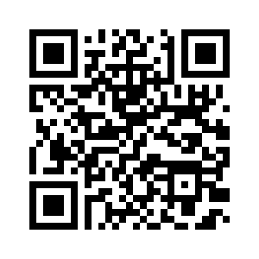
Link to PowerPoint presentations for all four workshops
www.mathsocialjustice.org/amesa-workshops/

