Slide 1
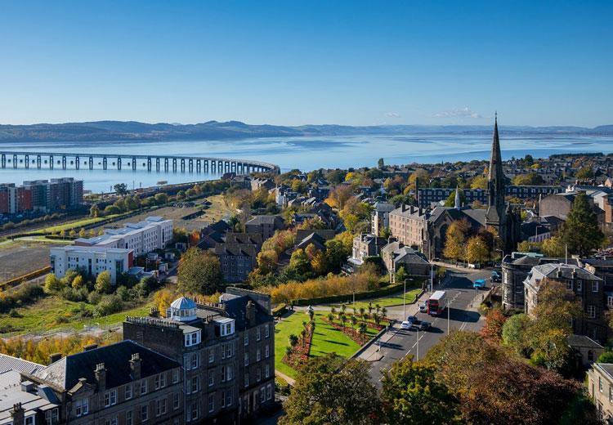
Workshop 2: visible mathematics pedagogy
Dr Pete Wright
Senior Lecturer (Education & Society)
University of Dundee
Scotland, United Kingdom
Contact:
pwright002@dundee.ac.uk
@petewright0
www.mathsocialjustice.org

Slide 2
Rationale for Visible Maths pedagogy (VMP) research project
Cycle of reproduction of inequities in society reproduced through school mathematics.
Progressive mathematics pedagogy, based on open-ended, problem-solving, discursive approaches, has the potential to address the attainment gap through raising agency, motivation, engagement of disadvantaged students.
In progressive maths classrooms, learning is less structured and the rules of the game for success are less clear (recognition and realisation rules).
Hence, danger that students from less wealthy backgrounds are further disadvantaged.
Option 1: Make teaching more structured and rules explicit – e.g. direct instruction – we are not interested in this! ☹
Option 2: Embrace progressive pedagogy whilst looking to make the rules of the game more explicit to learners in maths classroom – hence visible maths pedagogy; ☺
Refer to Visible Maths Pedagogy website for theoretical justification/research findings: www.visiblemathspedagogy.wordpress.com
(link from www.mathsocialjustice.org/links/)

Slide 3
Research question and strategies
Research question: Which strategies for making mathematics pedagogy more visible to learners can teachers use to help all students better recognise their intentions and achieve success when adopting progressive teaching approaches?
Strategies developed/trialled/evaluated by teacher researchers during the VMP project:
Advocating (explaining somebody else’s reasoning and not your own).
Separating (recording responses in a table with two or more columns).
Scribing (writing down responses using the exact words students use).
Classifying (getting students to identify different types of problem according to their characteristics).
Annotating (use a different colour pen to make notes on how a solution can be improved).
Combined with/followed by …
Discussion (asking students ‘Why do you think I asked you to …?)
Sorting (Using a card sort to make the teacher’s pedagogic rationale more explicit).

Slide 4
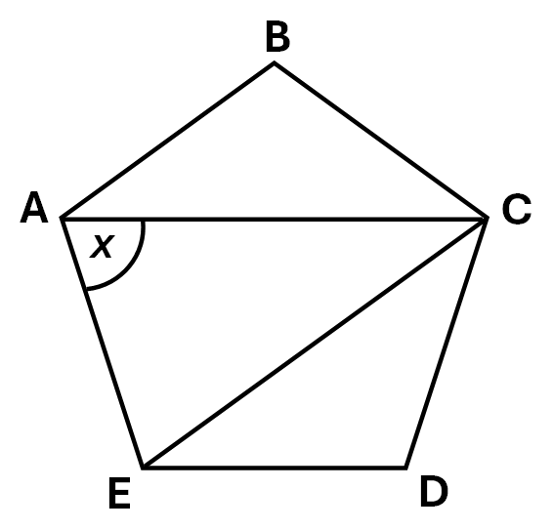
Modelling the strategies
ABCDE is a regular pentagon.
Find angle x.
Explain your reasoning.
Discuss (scribing and separating strategies):
Why do you think I wrote down exactly what you said?
Why do you think I wrote your responses in two columns?

Slide 5
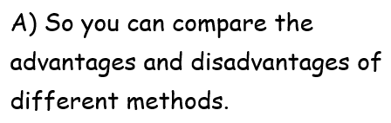

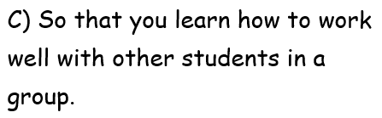
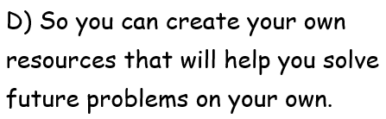

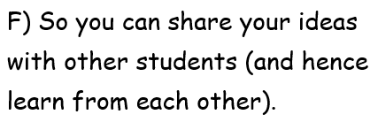

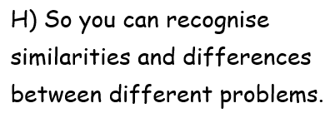

Card sort strategy
Classifying (getting students to identify types of problem according to their characteristics).
Annotating (use a different colour pen to make notes on how a solution can be improved).
Choose the reasons you think best match the reasons for using each strategy …

Slide 6
VMP research project Findings (1)
Students initially tended to misinterpret the teachers’ intentions, e.g. when asked ‘Why do you think the teacher asked you to explain your partner’s thinking and not your own?’ most saw ‘advocating’ as an attempt by the teacher to enforce listening:
  To see if you’re listening to your friend.
  Make sure you’re listening and learning.
… although some students better understood the purpose of ‘advocating’:
  So that we understand other’s point [of] view.
  Because you can get two different perspective[s] and it may help you finalise your idea.
However, over the course of the project, (particularly disadvantaged) students developed a greater awareness of the teacher’s pedagogical rationale, e.g. for the ‘scribing’ strategy, Marcus/Sophia described how this helped bring errors out into the open and correct them:
  To maybe see like where we go … because it’s better if you say it out than keep it in because the teacher could help you and try and improve from wrong to right (Marcus)
  Cos then you can compare the correct and incorrect answers together and see, like, where you went wrong, and how you, you know, changed the answer to get the correct one. (Sophia)

Slide 7
VMP research project Findings (2)
Disadvantaged students expressed high levels of enjoyment of progressive teaching approaches:
  I liked the partner work when you had to answer the starter. … yeah, that was fun. … I just like explaining myself to someone, cos that’s what I like to do instead of trying to figure it out by myself. (Sophia).
Whilst engaging with progressive teaching approaches, students did not lose sight of the importance of tests, describing how the strategies (in this case ‘annotating’) help prepare for these:
  It’s one day before a test … if you write in your book, then you can, when you go home, you can revise better. (Mary)
Some students continued to view success as completing large numbers of questions in a short space of time without difficulty:
  [I was successful] because I got most of the questions right, and … like, I understood how to do it. And I wasn’t really stuck, except for the last one (Ennis)
Others began to view success more as engaging with progressive teaching approaches used by the teacher:
  Well, I did pretty good … because me and [another student] … we did our own separate question. And then after we just worked it out together, after, to see if how we got the same answer, and then what method we did and see what’s the easier method. (Neal)

Slide 8
Discussion
What strategies could be used in your context?
What are the implications of the findings for practice?
How might the findings inform the work you do with teachers?

Slide 9
references
Wright, P., Fejzo, A. & Carvalho, T. (2022). Progressive pedagogies made visible: Implications for equitable mathematics teaching. The Curriculum Journal, 33 (1), pp. 25-41. http://doi.org/10.1002/curj.122
(open access)
Wright, P., Carvalho, T. & Fejzo, A. (2022). Visible mathematics pedagogy: A model for transforming classroom practice. Educational Action Research, 30 (2), pp. 168-191. https://doi.org/10.1080/09650792.2020.1850497
Wright, P., Fejzo, A. & Carvalho, T. (2020). Challenging inequity in mathematics education by making pedagogy more visible to learners. International Journal of Mathematical Education in Science and Technology, 53 (2), pp. 444-466. https://doi.org/10.1080/0020739X.2020.1775320
Wright, P. (2020): Visible and socially-just pedagogy: Implications for mathematics teacher education. Journal of Curriculum Studies, 52 (6), pp. 733-751. https://doi.org/10.1080/00220272.2020.1790667

Slide 10
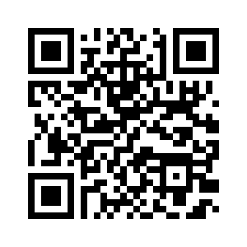
Link to PowerPoint presentations for all four workshops
www.mathsocialjustice.org/amesa-workshops/

