Slide 1

Workshop 3: curriculum change
Dr Pete Wright
Senior Lecturer (Education & Society)
University of Dundee
Scotland, United Kingdom
Contact:
pwright002@dundee.ac.uk
@petewright0
www.mathsocialjustice.org

Slide 2
initial DISCUSSION: successful curriculum change
Think about a curriculum change that has been unsuccessful.
Why was it unsuccessful?
Think about a curriculum change that has been successful.
What made it successful?

Slide 3
The purpose of mathematics education
What do you think is the main purpose of mathematics education?
Do you think other people would agree with you?
  Who would agree?
  Who would disagree?
What would most teachers of mathematics say?
Statement from Workshop 1:
Purpose: to develop children and young people as mathematical thinkers - individuals who can use precise reasoning, critical analysis, and connected understanding to make informed decisions, solve problems, and appreciate the patterns and mathematical relationships that shape the world.
(Draft initial statement for revised Scottish mathematics curriculum, December 2024)

Slide 4
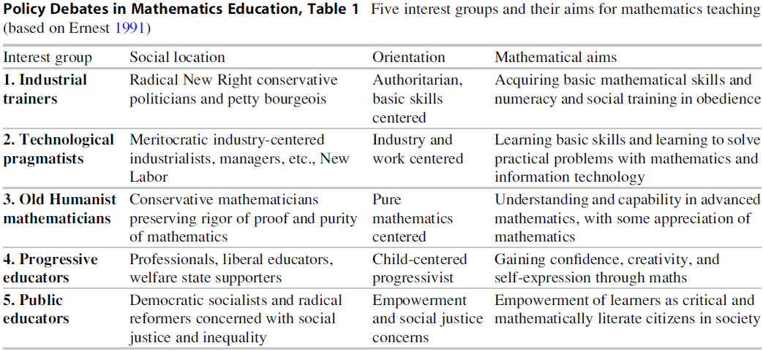
Ernest’s analytical framework: five ideologies of mathematics education
What are the implications for curriculum change?

Slide 5
Factors for successful curriculum change/reform
Should be seen as arising from a process of consultation (rather than imposed).
Should be seen as necessary and relevant to current needs of students/teachers/society.
Should take account of constraints faced by teachers and existing classroom situations.
Should focus on working collaboratively with teachers to enact changes in the classroom.
The rationale should be clearly understood by teachers and teacher educators/advisors.
The benefits should be apparent to teachers within a reasonable period of time.
Teachers need adequate time to engage with rationale/theoretical justification.
Should be separated from judgements and performance management of teachers.

Slide 6
Effective support for teachers – effective professional learning (wright, 2021)
To challenge current orthodoxies, teachers need to reflect critically on existing practice in relation to research evidence, rather than relying on adopting what works protocols (Winch, et al., 2013).
By engaging in collaborative inquiry, facilitated by external experts, teachers can be encouraged to take risks and explore why, and in which contexts, certain practices are effective (Cordingley, 2013).
Characteristics of lesson study: “it is sustained over substantial periods of time, collaborative within mathematics departments/teams, informed by outside expertise, evidence-based, research-informed, and attentive to the development of the mathematics” (Wake, et al., 2016, p. 245).
Critical reflection requires teachers to view their own practice as problematic and question the consequences of their actions in relation to wider historical/cultural/political contexts (Liu 2015).
External stimulus essential for promoting critical reflection – otherwise collaborative inquiry likely to perpetuate existing practice through the process of alignment with accepted norms (Jaworski 2006).

Slide 7
Participatory action research as effective professional learning
Participatory action research …
Promotes critical reflection and an understanding of the rationale behind change, through engaging with research literature, applying to existing practice, and external stimulus.
Recognises classroom constraints, teachers’ expertise and knowledge of context/students.
Prolonged engagement through a series of plan-teach-evaluate action research cycles.
Teachers given autonomy in deciding how to plan and evaluate actions (data collection).
Community of inquiry (across different schools) established to share ideas and resources, move beyond institutional constraints, provide mutual support and encouragement.
… to be explored further in AMESA 2025 Plenary Talk …

Slide 8
Implications for future practice
Discuss the following:
What ideas/strategies from this session are most likely to inform your future practice?
How might they inform your longer-term goals?
How might they inform your shorter-term goals … next steps?

Slide 9
references
Cordingley, P. (2013). The contribution of research to teachers' professional learning and development. London: Research and teacher education: The BERA-RSA Inquiry.
Ernest, P. (1991). The philosophy of mathematics education. London: Falmer Press.
Jaworski, B. (2006). Theory and practice in mathematics teaching development: Critical inquiry as a mode of learning in teaching. Journal of Mathematics Teacher Education, 9(2), pp. 187-211.
Liu, K. (2015). Critical reflection as a framework for transformative learning in teacher education. Educational review, 67(2), pp. 135-157.
Wake, G., Swan, M., & Foster, C. (2016). Professional learning through the collaborative design of problem-solving lessons. Journal of Mathematics Teacher Education, 19(2-3), pp. 243–260.
Winch, C., Oancea, A., & Orchard, J. (2013). The contribution of educational research to teachers' professional learning - Philosophical understandings. London: Research and Teacher Education: The BERA-RSA Inquiry.
Wright, P. (2021). Transforming mathematics classroom practice through participatory action research. Journal of Mathematics Teacher Education, 24(2), pp. 155–177.
https://doi.org/10.1007/s10857-019-09452-1

Slide 10
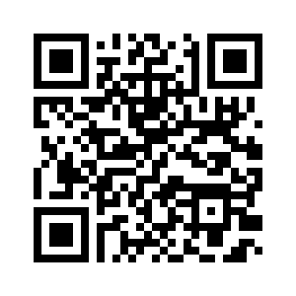
Link to PowerPoint presentations for all four workshops
www.mathsocialjustice.org/amesa-workshops/

