Slide 1
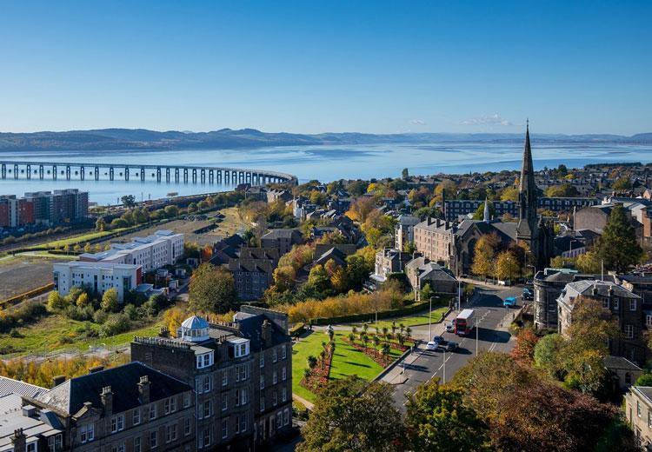
Workshop 4: critical mathematics education
Dr Pete Wright
Senior Lecturer (Education & Society)
University of Dundee
Scotland, United Kingdom
Contact:
pwright002@dundee.ac.uk
@petewright0
www.mathsocialjustice.org

Slide 2
What is Critical mathematics education?
A ‘critical mathematics education’ …
raises questions about the nature of mathematics and the purpose of education/schooling;
tackles issues of power and empowerment;
challenges the current situation, which is seen as perpetuating inequity and injustice.

Slide 3
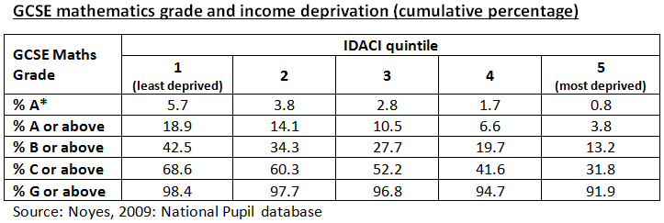
Inequality in outcomes
Discuss the data in the table above:
What does the data tell us? What might explain the data?
How might it compare to data relating to your own situation/context?

Slide 4
Reproduction of inequity
Often with a psychological brutality that nothing can attenuate, the school institution lays down its final judgements and its verdicts, from which there is no appeal, ranking all students in a unique hierarchy of all forms of excellence, nowadays dominated by a single discipline, mathematics.” (Bourdieu, 1998, p. 28)
Bourdieu’s theory of reproduction of inequity:
Middle-class children, through their upbringing, acquire greater levels of cultural capital, i.e. cultural resources recognised and valued by the school;
The main function of school is to reproduce social inequality (habitus);
Schools conceal power relations existing between groups and falsely attribute academic success to giftedness or merit (symbolic violence);
“Only those children who come already endowed with [linguistic] capital are in a position to make the most of the opportunities schools purport to ‘offer’ equitably to all children” (Noyes, 2008, p. 55).

Slide 5
Expectations and aspirations
Pygmalion in the Classroom’ study (Rosenthal & Jacobson, 1968)
Experiment in a US public elementary school, telling teachers that certain children could be expected to be growth spurters, based on the students' results on the Harvard Test of Inflected Acquisition. In spite of fact that the test was non-existent and those children designated as growth spurters were actually chosen at random.
Teachers raised expectations led to different interactions with children and hence growth spurters performed significantly better than others.
Pygmalion effect – expectations affect outcomes.

Slide 6
Reading and writing the world with mathematics
Gutstein (2006) argues that:
The current disempowering maths curriculum reflects the capitalist economy’s need for “an ever-growing army of low-skilled, compliant, docile, pleasant, obedient service workers”. (p.10)
Gaining mathematical power, i.e. confidence to engage in complex mathematical tasks involving communication, reasoning, problem-solving, is a necessary (but not sufficient) condition for empowerment.
Ideas based on Freire’s notion of conscientisation and praxis:
“People deepen their comprehension of the world through engaging in struggles to change their lives, and at the same time, they are more able to change society because they understand it better through actively participating in social change.” (p.28)
He argues that a critical mathematics education depends upon students changing their orientation towards maths and teachers appreciating the socio-political nature of maths education.

Slide 7
Reading and writing the world with mathematics (cont.)
Gutstein’s (2006) words:
“For me, reading the world with mathematics means to use mathematics to understand relations of power, resource inequities, … disparate opportunities between different social groups … explicit discrimination based on race, class, gender, language, and other differences … it means to dissect and deconstruct media and other forms of representation … to use mathematics to examine these various phenomena both in one’s immediate life and in the broader social world and to identify relationships and make connections between them.” (p.25)
“Writing the world with mathematics means using mathematics to change the world.” (p.27)

Slide 8
Reflecting on, with and through mathematics
Skovsmose (2011) argues that:
Maths education can be empowering (in a pragmatic sense, e.g. gaining employment) and disempowering (in a socio-political sense, e.g. ‘prescription readiness’) at the same time.
Learners should be encouraged to reflect …
… through mathematics by participating in ‘landscapes of investigation’, i.e. mathematical inquiries, making their own decisions, posing questions and interacting/communicating with other learners.
… with mathematics by using maths to gain a deeper understanding of a range of social, cultural, political, and economic situations.
… on mathematics by considering the nature and position of the subject, and how it can be used to make decisions and legitimise actions affecting themselves and others.

Slide 9
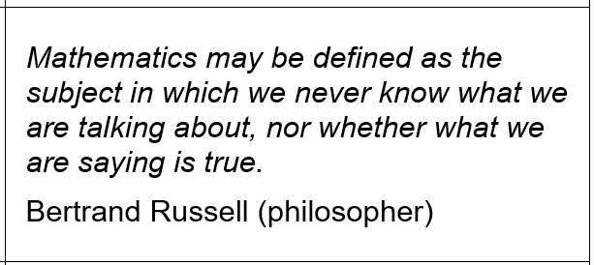
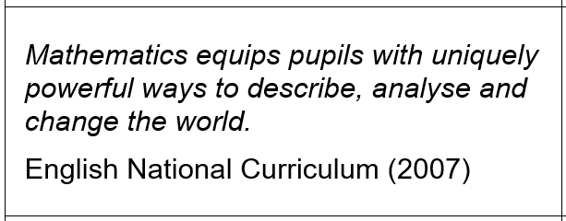
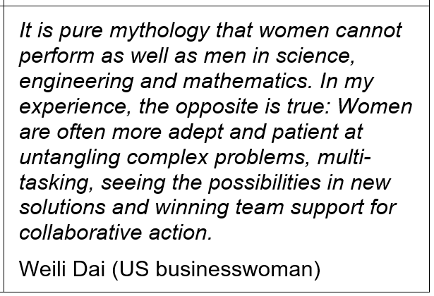
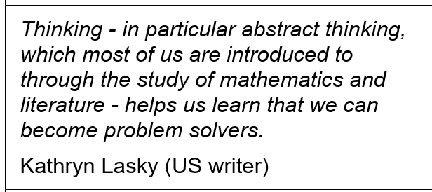
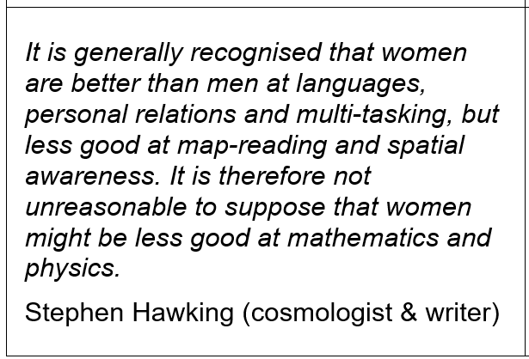
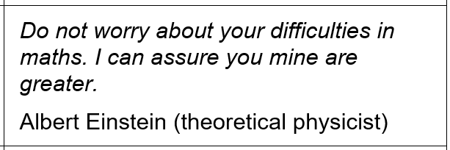
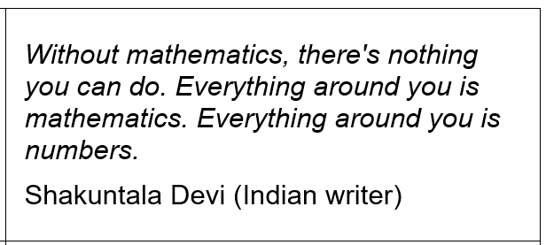
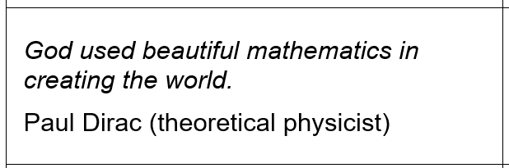
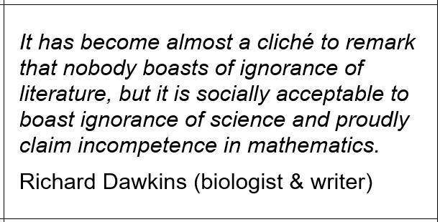
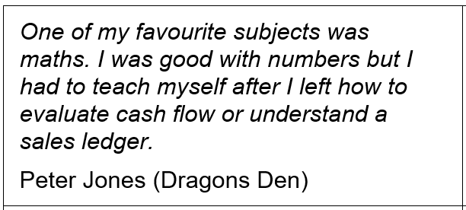
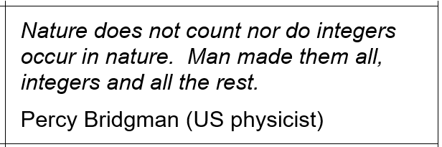
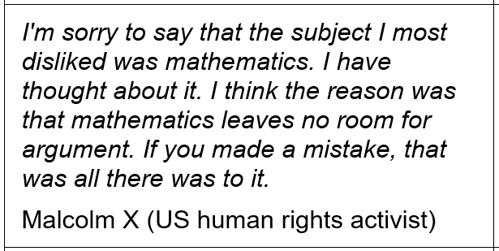
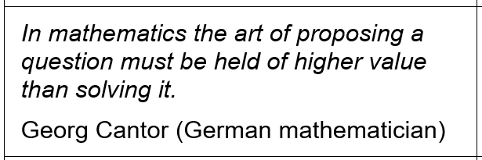
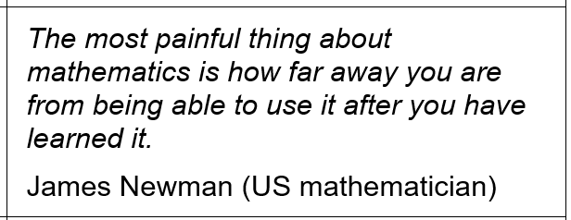
Card sort (group activity)
Discuss and sort the statements into those you most/least agree with …

Slide 10
reflection
Relate the starter discussion and the card sort activity to the critical mathematics education theories presented (Bourdieu, Gutstein, Skovsmose).
What was the purpose of the activities? How successful were they?
What are the implications for classroom practice?
How might you use the ideas and activities with teachers?

Slide 11
references
Bourdieu, P., 1998. Practical reason. Cambridge: Polity Press
Gutstein, E., 2006. Reading and writing the world with mathematics: Toward a pedagogy for social justice. New York: Routledge
Noyes, A., 2008. Mathematical marginalisation and meritocracy: Inequity in an English classroom. In: B. Sriraman, ed. International perspectives on social justice in mathematics education. Charlotte, NC: Information Age, pp. 51-68.
Noyes, A., 2009. Exploring social patterns of participation in university-entrance level mathematics in England. Research in Mathematics Education, 11(2), pp. 167-183.
Rosenthal, R. & Jacobson, L., 1968. Pygmalion in the classroom. The Urban Review, Volume 3, Issue 1, pp. 16-20
Skovsmose, O., 2011. An invitation to critical mathematics education. Rotterdam: Sense Publishers

Slide 12
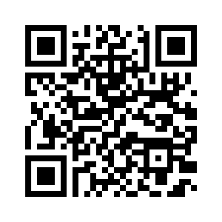
Link to PowerPoint presentations for all four workshops
www.mathsocialjustice.org/amesa-workshops/

