Slide 1
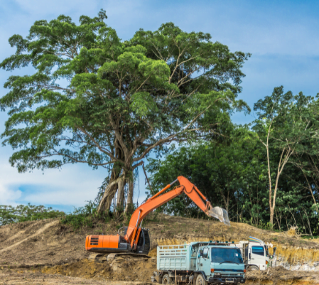
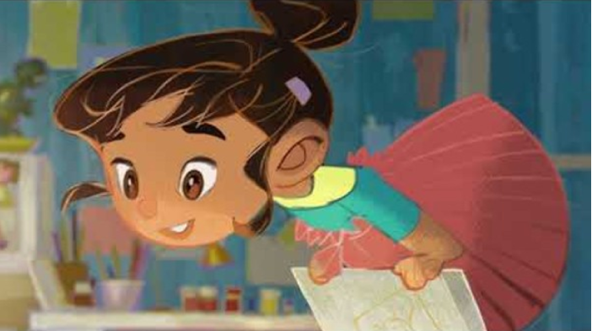
York St. John University
Secondary PGCE Mathematics and BA Honours Primary Education
19 June 2025
Teaching mathematics for social justice – students’ lesson ideas
Manjinder K. Jagdev
m.jagdev@yorksj.ac.uk
Notes:
Happy – Joy Crookes – diversity and difference is celebrated
1

Slide 2
Year 10 lesson on climate change:
Children’s feedback
I wonder if the progressing extreme heat will affect our animals and even, human beings. Will this affect us in dangerous ways? For example, will we die from heat stroke, will the water sources dry up and the animals die of thirst? These are my wonders for this graph.
learning this mathematics to challenge misleading / fake news
I already knew climate change was a problem, but understanding the statistics behind it allows me to see the scale of the problem and how it will affect our lives in the future.
    the experience was like being in future employment - all coming together to work on a task
For the YSJ ‘Doing Change: Education for social justice’ conference, the student teacher shared his work on ‘Critical Mathematics Education on Climate Change’, with students and staff.
Notes:
Context – second placement – Feb. PGCE mathematics – data handling and statistics of climate change including on island Tuvulu that is sinking – live video that the islanders are streaming so they have a record before the atoll is no longer there.
Joint lesson appraisal with mentor.
Discussion by pupils in groups and feedback.
The student began the lesson by sharing a video which was an excellent hook of up-to-date information that included graphs, percentages, area and temperatures relating to fossil fuel consumption. Pupils made comments about the ‘positive correlation’ they observed from the trend.
2

Slide 3

PGCE student teacher reflections
A critical mathematics education was incorporated into a Year 10 scheme of work on analysing statistics. The students all came up with fascinating statistics on climate which motivated them to want to understand the problem. The students collaborated in group projects and produced well-informed data driven discussions across the classroom. The sequence of lessons had many positive impacts, including:
Develops critical thinking skills by questioning assumptions,
challenging narratives and engaging in meaningful discussions.
Promotes social justice and equity as students are informed and engaged in
socially responsible mathematical practices.
Enhances problem-solving skills by learning to approach problems in a critical and reflective manner, students become better problem-solvers and are better equipped to tackle complex issues in a variety of fields.
Increases engagement and motivation because they see the relevance and
importance of the subject matter to their lives and the world around them.
Fosters creativity and innovation through approaching problems from multiple perspectives.
Notes:
One pupil stated that often when working on their own, they get stuck and do not what to do. In this lesson’s scenario, it was better because they could discuss their ideas: ‘teamwork helps us work it out.’ Making links with other curriculum subjects like science and geography.
All pupils were engaged in the digital film about the island of Tuvalu that the islanders are creating. The learners accessed the ‘Climate Change Analysis’ activity about correlation and lines of best fit in a real-life context. They made positive statements about their mathematics learning, for example, ‘mathematics in context, application of mathematics’.
3

Slide 4
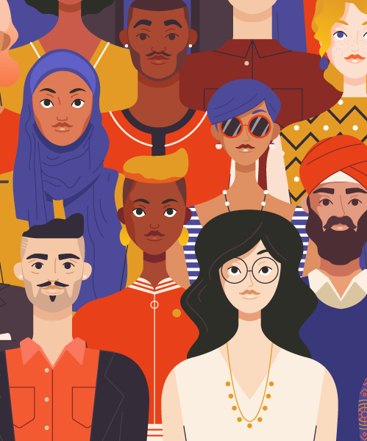
PGCE Secondary mathematics student feedback
I think, where possible, I will embed critical maths education in all areas. For instance I’m teaching about salaries to year 9 next week and will try to open a discussion about the two wages I have put on the board, a cleaner at £20k and a Software Engineer at £50k. I am also experiencing similar things inadvertently in other lessons too, and it’s made me realise I wasn’t prepared for some questions - for example I started to teach lattice multiplication as a method of decimal multiplication and referred to it as Napier’s bones. The first questions were “why is it called that?”, followed up by “Who was Napier?” - to which I couldn’t answer. What I should’ve done in the lesson is google after I set some independent work but I’m going to try to think about that in advance for next time.
The implications for children is that if we don’t raise these, at least in part, then we have not done all we can to help prepare the students for the real world. It may be that they forget everything, but that doesn’t matter. It is important to include critical maths and social justice themes for the reasons above, as well as for the wider impacts and cross-curricular connections that could be made by doing so. If we talk about Alan Turing in maths and History are doing a WW2 topic and do the same then we might start marking more connections in the brain and the students may remember more of the content.
Notes:
Following session in January 2024. social justice links – fair wages and salaries/ minimum wage; connection to History.
Alan Turing and Katherine Johnson connected to code breaking and problem solving at the end of a lesson with Year 8 – culturally relevant – sexuality and racism – emotional dimension in mathematics education.
4

Slide 5
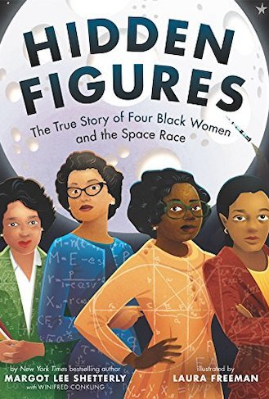

Females in mathematics and science
As a plenary to his lesson with a class of 13-year-olds, this student teacher linked the problem-solving activities that the class had worked on to Alan Turing’s code breaking and Katherine Johnson’s mathematical calculations that sent the first man into space. His pupils responded to his questions about their cultural relevance, and he explained to the class how Alan Turing experienced homophobic injustices whilst African American women, including Katherine Johnson, faced racism and fought for desegregating higher education. He linked this to human suffering and fairness.
more-than-half-of-british-girls-lack-confidence-learning-maths-poll-finds
8 February 2024
Notes:
Black Majority role models for all.
Guardian article and girls’ confidence in mathematics and science
5

Slide 6
PGCE secondary mathematics lesson on minimum wages
Multiplying decimals in the context of calculating minimum wages for different ages groups around the world (April 2024 and 2025):
Fiji: FJD 4.50 hour
Papua New Guinea: PGK 3.50 hour
Calculating exchange rates to compare to GB Pounds.
Discussion and children’s comments….
Notes:
McDonalds; Chinese wages
6

Slide 7
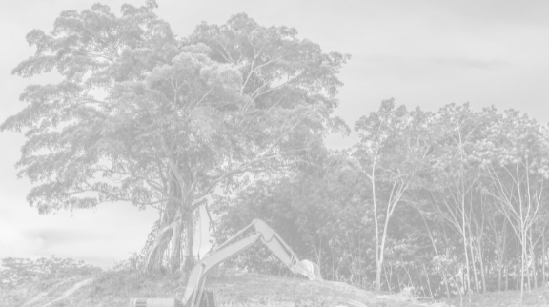
BA Education: Year 2 Primary mathematics national curriculum links – lesson ideas
Fast fashion; homelessness
Air quality, Australian Forest fires, Turkish and Syrian Earthquake crisis; carbon emissions; carbon footprints
Food miles; food poverty; Rate of inflation for food; Sharing food and resources - chocolate and fair trade; food waste; healthy diets
Environments around the world - mountains, rainforests and cities; Deforestation, Climate change, Rising sea levels; global warming and melting ice caps
Saving sea turtles (plastic pollution); Landfill pollution, Plastic consumption, Pollution in the oceans and seas; litter in the ocean; litter picking; recycling; water pollution
Cost of living crisis, Fair trade and sustainability; Budgeting
Biodiversity, endangered animals; creating a butterfly garden; dog rescue

Slide 8
Student teachers’ lesson activity | National curriculum links and co-creation of activity with pupils | Student teachers’ comments / hyperlinks
Landfill pollution | 2D and 3D shapes in rubbish, measurement, area of land needed for landfill, large numbers, estimation, prediction, surface area and volume of greenhouse made up of recycled plastic bottles | Landfill is one of the biggest concerns of climate change​. Water filters through the waste in landfill and forms leachate – a highly toxic, foul-smelling liquid. Materials such as PVC and e-waste leach toxic chemicals as they break down. ​ Landfill sites release methane, a greenhouse gas that's between 28 and 34 times more potent than carbon dioxide.​ Take up habitats for animals.
Recycling | bar graphs interpretation; data collection percentages, averages (mean, median and mode) - co-creation of activities with pupils to increase recycling; trends; plastic packaging waste; shape 2D and 3D); graphs and pie-charts; fractions. | Litter picking for half an hour each week over a half term/ prolonged period. ​ Collecting data from this activity, such as how many bags collected.​ They would do this in school or in the local area just outside. ​ Finding out how many bins are nearby and petitioning to add more so that there is less litter. ​ Sorting it out and finding out what percentage you can recycle. ​ Litter picks around the school.
Plastic consumption | percentages, decimals, line and bar graphs, estimation, pattern spotting, reading and writing large numbers, weight grams and kilograms) | Effects of plastic on humans - It is said apples and pears have an average of 195,500 and 189,500 particles per gram respectively, whereas vegetables like broccoli and carrots average more than 100,000 plastic fragments per gram. How much plastic in total would you consume in total from eating these fruits and vegetables?​ How many more plastic fragments do apples contain compared to broccoli?​
Rising sea levels | Units of measurement – feet, metres, centimetres.​ ​ Measures of central tendency – mean, mode, median, range.​ ​ Use of tables and graphs.​ | In England, sea levels are rising by 3-5mm a year​. ​ In China, sea levels are rising by 4mm a year​. ​ In Australia, sea levels are rising by 2-5mm a year​. ​ Using multiple examples from different countries, children can then find the mean, mode, median and range. ​
Deforestation | Shapes, estimation, height, measure; reflection; shapes and curves; symmetry.​ geography | Deforestation is an issue which affects both human life and other species such as jaguars and orangutans. This affects their homes as well as causing high noise levels. The number of trees we have now are almost half the amount there was when humans first evolved meaning up to 15 billion trees are being cut down each year across the world which is affecting the climate due to the lack of trees, not as much carbon dioxide can be absorbed which is contributing to global warming by 10% (WWF, 2019)​ Find the age of a living tree using mathematics.​ Bringing mathematics into forest schools.

