Slide 1
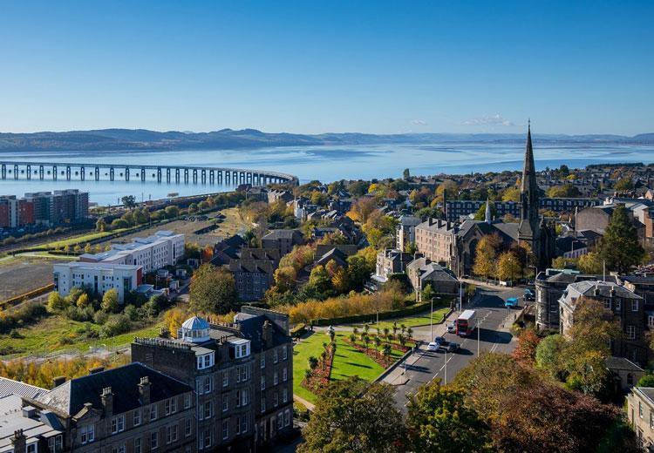
REFLECTIONS ON PROMOTING EQUITABLE AND SOCIALLY JUST MATHEMATICS TEACHING APPROACHES
Dr Pete Wright
Senior Lecturer (Education & Society)
University of Dundee
Scotland, United Kingdom
Contact:
pwright002@dundee.ac.uk
@petewright0
www.mathsocialjustice.org

Slide 2
Structure of presentation
Something about me and my positioning.
Critical model of participatory action research (PAR).
Brief overview of four PAR research projects.
Four essential components of socially just mathematics teaching (SJMT).
How each component is informed by theory and project findings.
Opportunities for you to reflect/engage (briefly) with some activities.
Refer to accompanying paper for more details and references.

Slide 3

Something about me and my positioning
Completed maths degree in 1986, and teacher qualification in 1987.
Spent 15 years as secondary maths teacher (England and Kenya).
Spent 5 years in curriculum development and 2 years as advisory teacher.
Became teacher educator researcher in 2011 – completed EdD in 2015.
Career-long commitment to socially just mathematics teaching.
More recent engagement with theory – better understanding of practice.
Recognition of privilege – citizen of state that benefits from global inequity.
I will present findings relating to my context – you decide if they are transferable to your own context.

Slide 4


Initial reflection
Imagine what a socially just maths classroom would look like.
Imagine what a socially unjust maths classroom would look like.
What characteristics would you see that distinguish one classroom from the other?
Make a note of your reflections for future reference.

Slide 5
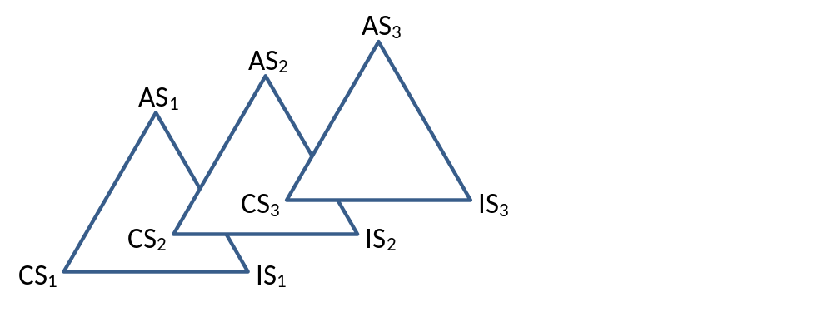
Critical model of participatory action research (PAR)
Collaborative research with (rather than on) teachers.
Emancipatory and socio-political in nature.
Assumes current situation not taken as given (critical).
Model includes imagined situation and arranged situation.
Research team – recognises complementary knowledge and skills.
Teacher researchers (TRs) play leading role in research design.
TRs engage with literature, plan-teach-evaluate cycles, data collection.
PAR takes account of classroom constraints – findings more relevant to practitioners.

Slide 6
The four PAR research projects

Slide 7
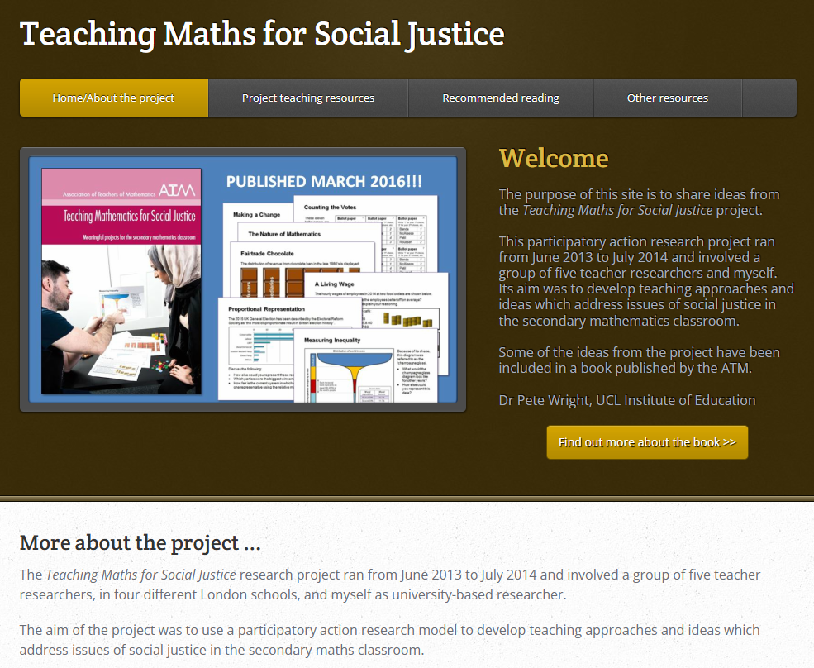
First research (PAR) project: teaching maths for social justice (TMSJ)
Collaboration with 5 maths TRs in second year of teaching.
Four ethnically-diverse secondary schools in areas of relatively high deprivation in London.
Focus was on exploring strategies for translating theories of TMSJ into classroom practice.
Findings:
Critical reflection through engaging with theory and mutual support of research team transformed TRs’ thinking and practice.
TRs shifted towards promoting progressive pedagogies and student agency, and challenging systemic causes of inequity.
Students, particularly those previously alienated, increased their motivation and engagement as they began to see maths as more meaningful.
www.maths-socialjustice.weebly.com/
(see www.mathsocialjustice.org/links/)

Slide 8
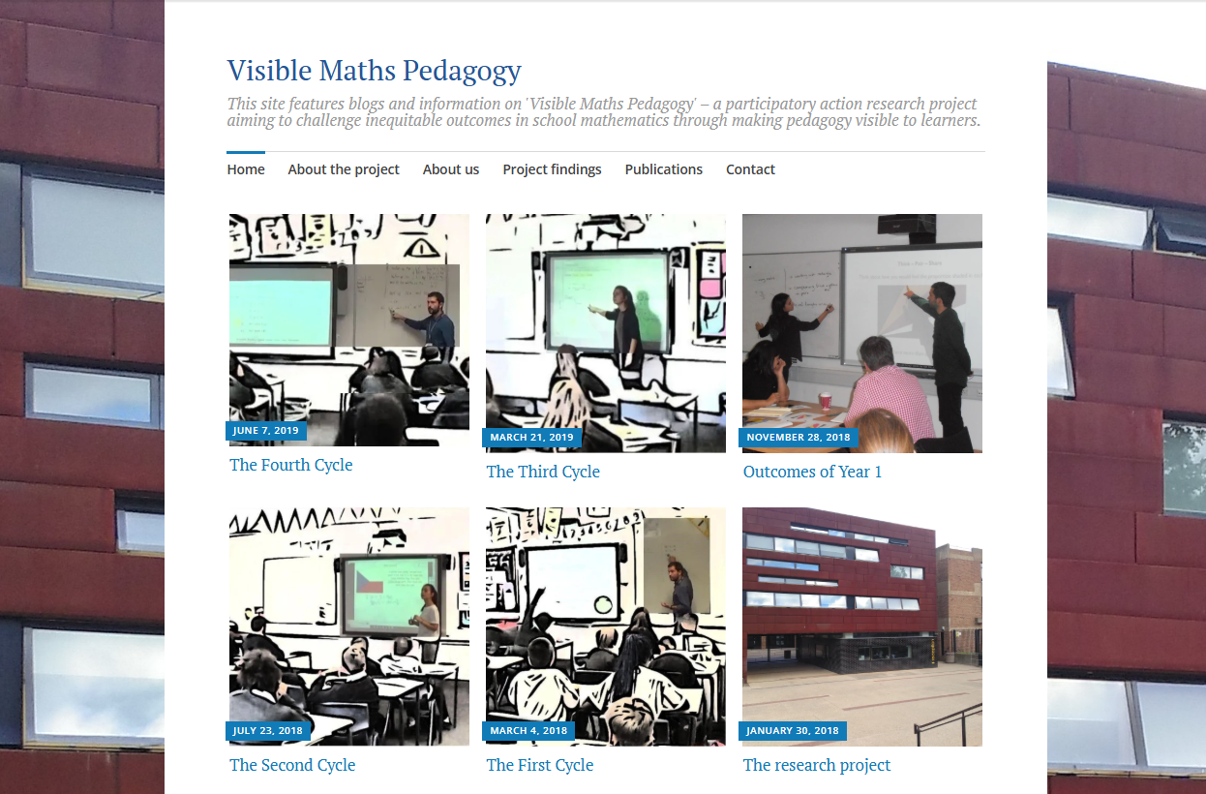
second research (PAR) project: visible maths pedagogy (VMP)
Collaboration with 2 maths TRs (with various experience).
Ethnically-diverse secondary school in London with significant proportion of students from marginalised groups.
Focus was on developing strategies that enable all students to recognise the teacher’s intentions when using progressive teaching.
Findings:
Prompting open discussions with students helped all learners develop greater appreciation of teachers’ pedagogic rationale.
Teachers developed better understanding of pedagogic rationale.
Students from marginalised groups achieved greater success when experiencing progressive pedagogies.
www.visiblemathspedagogy.wordpress.com
(see www.mathsocialjustice.org/links/)

Slide 9
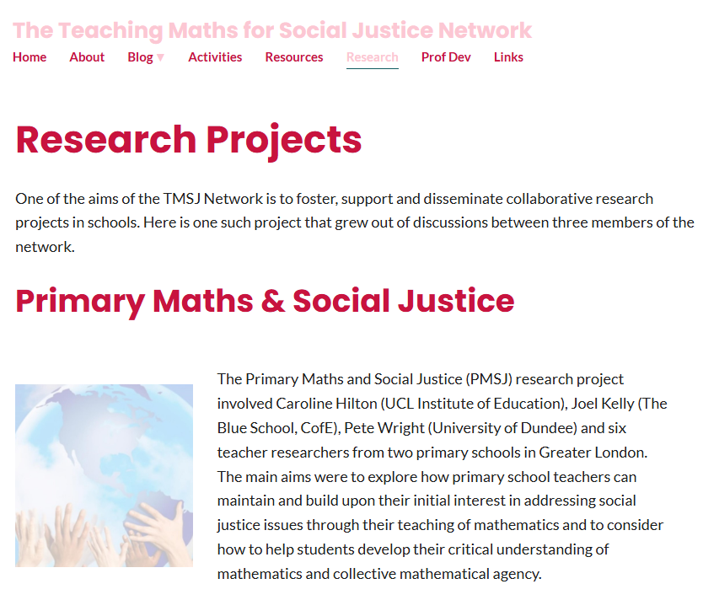
third research (PAR) project: primary maths and social justice (PMSJ)
Collaboration with 2 co-researchers and 6 TRs (various experience).
Two culturally-diverse primary schools in London.
Focus was on enabling students to make stronger connections between what they learn in discrete maths lessons and social justice issues tackled through project-based learning.
Findings:
Teachers helped students to develop a greater capacity to use the mathematical knowledge they have learnt in constructing collective arguments for change (referred to as socio-mathematical agency).
Students (and teachers) developed more positive dispositions towards maths as they began to appreciate how it can be applied, in meaningful and relevant ways, to their own interests and experiences.
www.mathsocialjustice.org/research/

Slide 10
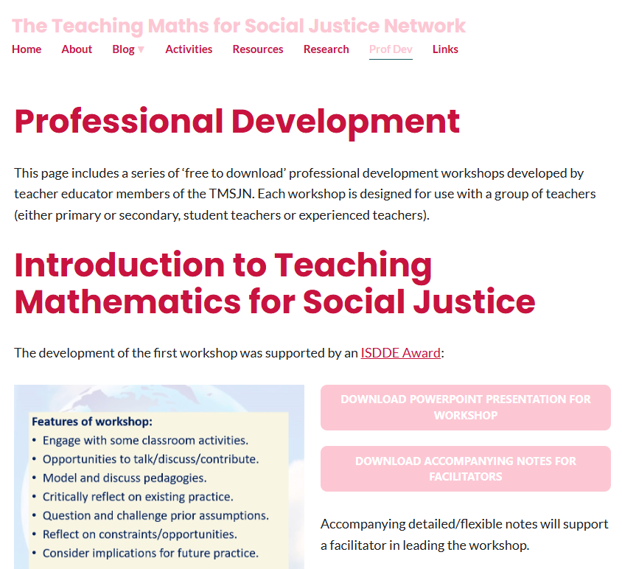
fourth research (PAR) project: promoting socially just maths teaching (PSJMT)
Collaboration with 12 maths teacher educator researchers (TERs) from different universities in England and Scotland.
Focus was on exploring how TERs can promote socially just pedagogies and practices amongst student/experienced teachers.
Findings:
Teachers are generally keen to engage with issues of equity and social justice in the mathematics classroom, but face constraints in doing so (lack of time, need to cover curriculum).
TERs identified strategies for overcoming these constraints including establishing networks of teachers.
Designed series of three professional development workshops for teachers (focusing on inclusion, engagement, problem-solving).
www.mathsocialjustice.org/prof-dev/

Slide 11
The four essential components of SJMT

Slide 12


First essential component of SJMT: progressive pedagogies
Promote collaboration, dialogue, problem-solving, exploration.
Focus on developing agency, posing questions, communication.
Embrace multiple solutions and errors as learning opportunities.
The TMSJ, VMP, PMSJ projects showed how progressive pedagogies increase students’ engagement, motivation, enjoyment.
Discuss the three prompts below with colleagues (near you):
What fraction of each flag is coloured blue, white and red?
Find more than one way of explaining your answers.
Make notes on somebody else’s reasoning ready to present these to the whole group.
Flag of Czechia
Flag of Seychelles

Slide 13
First essential component of SJMT: progressive pedagogies (cont.)
Some evidence suggests students from marginalised groups are more likely to misinterpret the teacher’s intentions when using progressive pedagogies – hence less likely to achieve success.
The VMP project developed strategies for making pedagogic rationale more explicit, e.g. by asking:
“Why do you think I asked you to … present somebody else’s reasoning?”
Initial responses from students tended to be along the lines of: “To see if you’re listening to your friend.” … or … “Make sure you’re listening and learning.” (Student survey responses)
By the end of the VMP project, students became better at correctly interpreting the teacher’s rationale, with more responses similar to: “So that we understand other’s point [of] view.” … or …
“Because you can get two different perspective[s] and it may help you finalise your idea.” (Student survey)
Through making the teacher’s pedagogic rationale more visible in the VMP project, students (particularly those from marginalized groups) were better able to respond appropriately and achieve success when the teacher employed progressive teaching approaches.

Slide 14
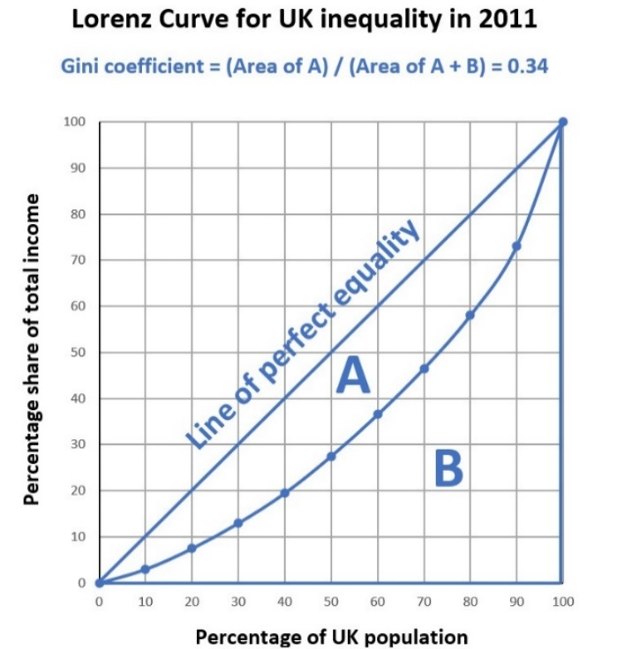
second essential component of SJMT: meaningful inquiry
Mathematics can be used as a powerful tool to better understand the world and how we relate to it.
Children and young people tend to be passionate about issues of fairness, climate change and social justice.
Most contexts students encounter in maths lessons are superficial in nature and of little interest to them.
Identifying and exploiting genuine links between mathematical concepts and social justice issues can lead to better understanding of the issues and the maths.
Which mathematical ideas could you use to calculate the Gini Coefficient for the Lorenz Curve shown?

Slide 15
second essential component of SJMT: meaningful inquiry (Cont.)
The TMSJ, PMSJ projects showed how students’ engagement increased dramatically when given the chance to apply maths to real-life issues. This was particularly true for students previously alienated from maths.
  “I tried a few things with my bottom set and their motivation has just been so high in those particular lessons that I’ve had to very rarely like tell them to get on with things or to do things.” (Anna, TR on TMSJ project)
  “In general, I do not enjoy maths as I think I’m not very good at it. Today I enjoyed the maths lesson as I enjoyed finding out about fair trade and I liked seeing all the statistics of the money different people make from a bar of chocolate.” (Year 9 student, TMSJ project).
The increase in engagement was attributed to students beginning to see how maths can be more meaningful:
  “The children were very engaged. I think the fact that they were attributing it to a real-life problem or challenge. So, they really took ownership over setting their own investigations and then understood very much how maths can be related to real life.” (Layla, Year 6 TR on PMSJ project)

Slide 16
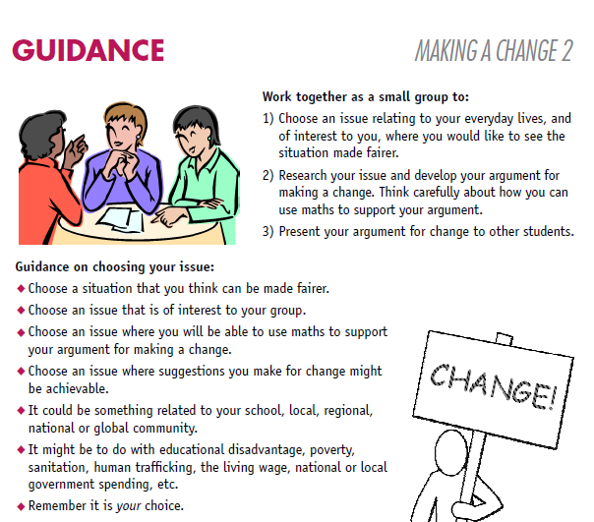
third essential component of SJMT: collective agency
Maths lessons tend to be characterised by students working individually, in silence, on closed tasks.
And yet, where maths is used to solve problems in real life, this is usually done by teams of people.
Developing learners’ critical understanding and collective agency is essential if we are to address the social, political, economic and environmental challenges facing society.
In the TMSJ project, the ‘Making a change’ activity encouraged groups of students to choose a social justice issue of interest to them, research it, use maths to construct an argument in support of a change they would like to see made, then present their argument to the rest of the class.

Slide 17
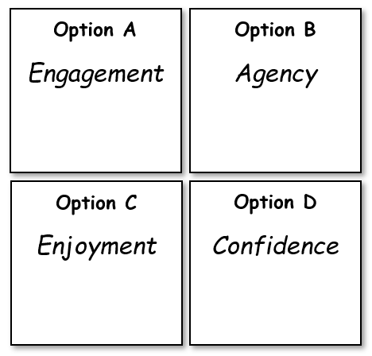
third essential component of SJMT: collective agency (Cont.)
Discuss the following in a pair/small group:
We (as a congress) need to decide which option is most important to focus on first when considering SJMT.
Imagine each group has 10 counters to allocate to the 4 options.
Agree how your group should allocate its 10 counters?
In the PMSJ project, students were asked to make decisions in this way,
e.g. in deciding which fun activity to choose as a class reward.
Questions such as these were used to prompt a discussion after the decision:
How fair was the method?
Do you think your view was taken into account? What about other people’s views?
How many counters should each group allocate to their first/second/third/fourth choice?
How big should the groups be? How many counters should be allocated to each group?

Slide 18
third essential component of SJMT: collective agency (cont.)
The TMSJ, PMSJ projects demonstrated the benefits of using activities like these for developing students’ socio-mathematical agency, i.e. the capacity to use mathematics effectively in arguing collectively for social change.
For the ‘Making a change’ activity …
“They were all so passionate about the things they were presenting about, was the key thing, and the fact that they got to actually tell everyone what they found out.” (Anna, TR on TMSJ project)
For collaborative decision-making …
“I think the major impact is just that they're actually learning how to give an opinion … And understanding that they can apply maths to situations that are not just in the classroom, and things that affect them.”
(Emma, Year 1 TR on PMSJ project)
“And then they worked with their talk partner to talk about their views. And there was some quite heated discussion amongst them. And at that point, they were really keen then to come up with some different ideas, which they thought might be fairer.” (Kate, Year 1 TR on PMSJ project)

Slide 19
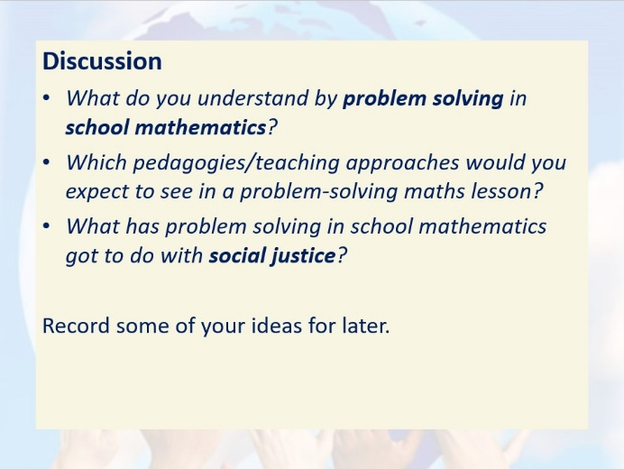
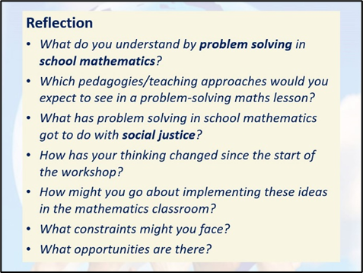
fourth essential component of SJMT: challenging myths and discourses
Common myths contribute towards structural inequity in maths education. These include the following:
  School mathematics is a level playing field.
  Success is determined by natural ability.
  Maths is culture-free and value-free.
  Maths is all about right and wrong answers.
Teachers and students need to reflect upon the nature of mathematics, its purpose and position in society.
All four projects show how critical reflection can prompt TRs to question their prior assumptions and beliefs, and challenge discourses they encounter in schools.
Critical reflection was a key design principle of the PSJMT professional development workshops.

Slide 20
Follow-up reflection
(mirroring structure of P.D. workshops)
Reflect on your earlier thoughts:
Imagine what a socially just maths classroom would look like.
Imagine what a socially unjust maths classroom would look like.
What characteristics would you see that distinguish one classroom from the other?
Make a note of your reflections for future reference.
How has your thinking changed having engaged with this presentation?

Slide 21
Concluding thoughts: take-away task
Consider how transferable the findings of the projects are to your own context.
Reflect on the implications of the essential components of SJMT for your practice:
Employ progressive pedagogies that promote mathematical sense-making and the engagement of all learners with mathematics.
Promote mathematical inquiries that resonate with learners’ real-life experiences and that help them develop greater understanding of their social, cultural, political, and economic situations.
Facilitate mathematical investigations that develop learners’ individual and collective agency, enabling them to take part in future social action for the public good.
Challenge myths and discourses surrounding school mathematics, expose processes that lead to the marginalisation of some learners, and open up to scrutiny what it means to be successful.
Link to PowerPoint presentation:

