Slide 1

Workshop 1: Socially just approaches to inclusion in mathematics
One of a series of professional development workshops on promoting socially just mathematics teaching developed by members of the Teaching Maths for Social Justice Network and freely available via the network’s website: www.mathsocialjustice.org
The development of this workshop was supported by funding from the BERA Small Grant Fund awarded to Pete Wright and a team of co-researchers from the TMSJN.
Notes:
Emphasise that this workshop, and others in the series, are free to download - they are accompanied by detailed/flexible notes for facilitators.

Slide 2
Features of workshop:
Engage with some classroom activities.
Opportunities to talk/discuss/contribute.
Model and discuss pedagogies.
Critically reflect on existing practice.
Question and challenge prior assumptions.
Reflect on constraints/opportunities.
Consider implications for future practice.
Notes:
Outline features of the workshop.

Slide 3
Why is inclusion a social justice issue?
“The right to education aims to ensure everyone achieves their human right to access quality education throughout life. An inclusive approach to education means that each individual’s needs are taken into account and that all learners participate and achieve together. It acknowledges that all children can learn and that every child has unique characteristics, interests, abilities and learning needs. Special focus is placed on learners who may be at risk of marginalization, exclusion or underachievement. For example, where a child has a disability he or she would not be separated from other learners in school and learning assessments and progress would take the disability into account.”
UNESCO (2024) What you need to know about inclusion in education
Notes:
Use the quotes on the next two slides (take brief comments only) and the discussion on slide 5 to draw out links between inclusion and social justice.
Emphasise that these quotes offer different perspectives to prompt discussion and are not meant to be definitive answers.
Note the following terms are also considered to relate closely to what we mean by ‘inclusion’: differentiation, adaptive teaching, meeting the needs of all learners, attainment grouping, scaffolding, additional needs.

Slide 4
Why is inclusion a social justice issue?
“Critical [socially just] mathematics education is concerned with the social and political aspects of the learning of mathematics. It is concerned with providing access to mathematical ideas for everybody independent of colour of skin, gender and class. It is concerned with the use and function of mathematics in practice, being an advanced technological application or an everyday use. It is concerned with the life in the classroom, which should represent a democratic forum, where ideas are presented and negotiated. It is concerned with the development of critical citizenship.”
(Skovsmose & Borba, 2004)
Notes:
See notes on previous slide.

Slide 5
Why is inclusion a social justice issue?
Keep a record of the following (for later reflection):
Imagine a non-inclusive mathematics lesson
(or think about one you have observed recently).
Describe what you see.
Who is excluded?
How are they excluded?
How does this exclusion relate to …
  Learning activities? Teaching approaches?
  Classroom organisation? Resources?
  Expectations of the whole class/individuals?
Notes:
Take feedback from participants. Find a way of recording notes to provide a useful comparison with reflections later in the workshop. This might be by collating the group’s ideas on a flipchart/poster/Padlet/Mentee or asking individual participants to record their thoughts.

Slide 6
Discussion
To what extent do you agree or disagree with the following statements …?
Inclusive maths classrooms are hard.
All maths learning is measurable.
All maths learning happens one small step at a time.
All maths learning happens sequentially.
Different learners need different activities.
Maths learning happens best in controlled environments.
Maths learning happens best if the teacher has a clear learning goal in mind.
All children can access the maths curriculum with the right adaptations.
Children's maths work should be neat and tidy.
A good maths lesson plan can be taught by any teacher with the same outcome.
Students with EAL need maths tasks that are less demanding.
Notes:
Divide participants into groups of 3 or 4.
The statements could be copied onto cards (use Appendix 1 in facilitators’ notes) and participants asked to decide (as a group) whether they agree or disagree with each statement in turn. Alternatively, they might be asked to decide whether each statement is always/sometimes/never true, or they might be invited to order the statements into those they agree with most/least.
Participants could be invited to add examples or pictures to the statements.
The aim of this activity is to provide ‘gentle challenge’ and to plant the idea that some statements may be common myths.
Draw this out through discussion and invite participants to suggest another ‘common myth’ (record on blank card).

Slide 7
What do you notice? What do you wonder?
The following slides have some prompts from the YouCubed website (https://www.youcubed.org/ ) that can encourage students to identify and communicate mathematical ideas and pose their own questions to explore.
These prompts can help to transform students’ mindsets:
Students with a fixed mindset are those who are more likely to give up easily, whereas students with a growth mindset are those who keep going even when work is hard, and who are persistent.
(YouCubed: https://www.youcubed.org/resource/growth-mindset/ )
Choose some of the prompts to explore. For each prompt:
Think about: What do you notice? What do you wonder?
To what extent is the activity socially just? Why?
Consider how you might use the prompt to promote inclusive practice within a mathematics classroom.
Notes:
Provide background to the activities.
Familiarise participants with the questions to consider for each prompt.
You may not have time to look at all four activities.
It is better to look at some prompts in greater depth than to try and get through all four prompts.
Spend no more than 5 mins on each prompt.

Slide 8
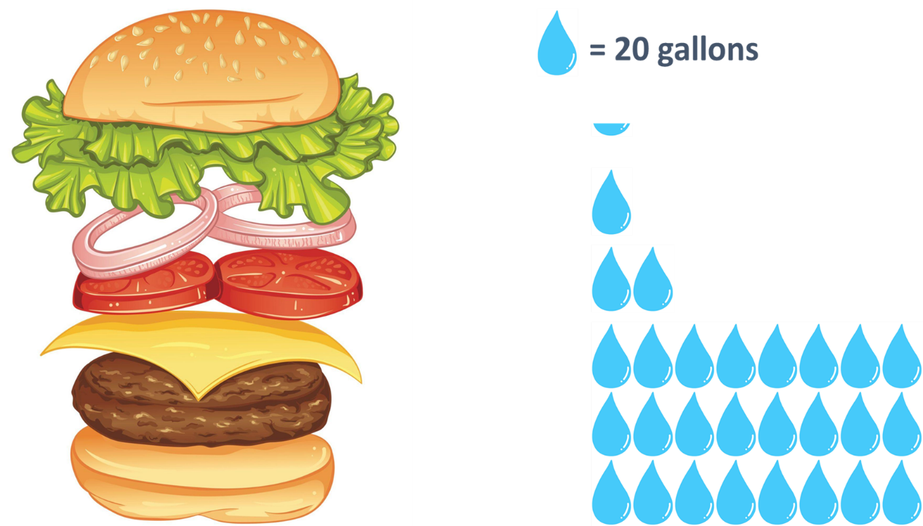
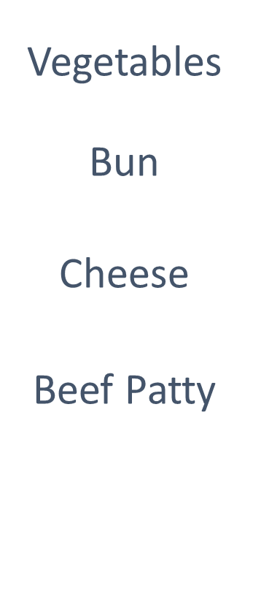
  What do you notice? What do you wonder?
  The Hidden thirst of a burger
Notes:
Full Data Talk: https://www.youcubed.org/resources/bunbelievable-the-hidden-thirst-of-a-burger/
Source: https://link.springer.com/article/10.1007/s10021-011-9517-8#Sec9
A Global Assessment of the Water Footprint of Farm Animal Products by Mesfin M. Mekonnen and Arjen Y. Hoekstra (2012).
Note that you may wish to discuss the context of this activity (and those on the following slides). This activity seems inspired by a (Western/capitalist) fast food culture.
This might prompt a debate about whether culturally specific contexts should be avoided altogether (due to any potentially problematic assumptions), or whether they should be used with an accompanying critical discussion with students about any cultural assumptions they make.
Slides 8 and 9 are reproduced in a printable form as Appendix 2 in the facilitators’ notes.

Slide 9
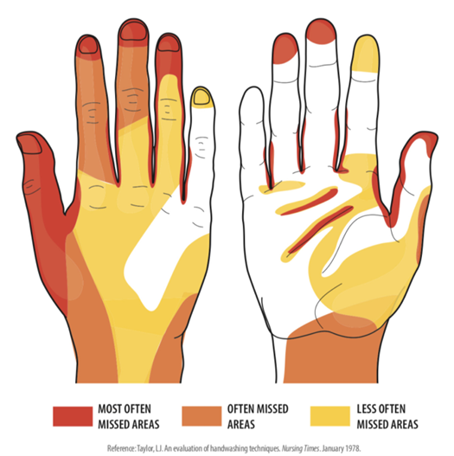
  What do you notice? What do you wonder?
  Most often missed areas while washing hands
Notes:
https://www.youcubed.org/wp-content/uploads/2020/09/HandWashing.pdf
https://flowingdata.com/2020/02/18/most-often-missed-areas-while-washing-hands/

Slide 10
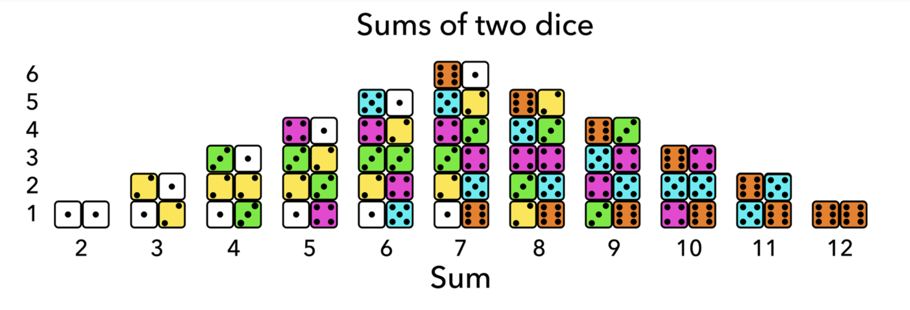
  What do you notice? What do you wonder?
  Sums of two dice
Notes:
https://www.youcubed.org/wp-content/uploads/2020/09/Dice-Sums-2.pdf
Slides 10 and 11 are reproduced in a printable form as Appendix 3 in the facilitators’ notes.

Slide 11
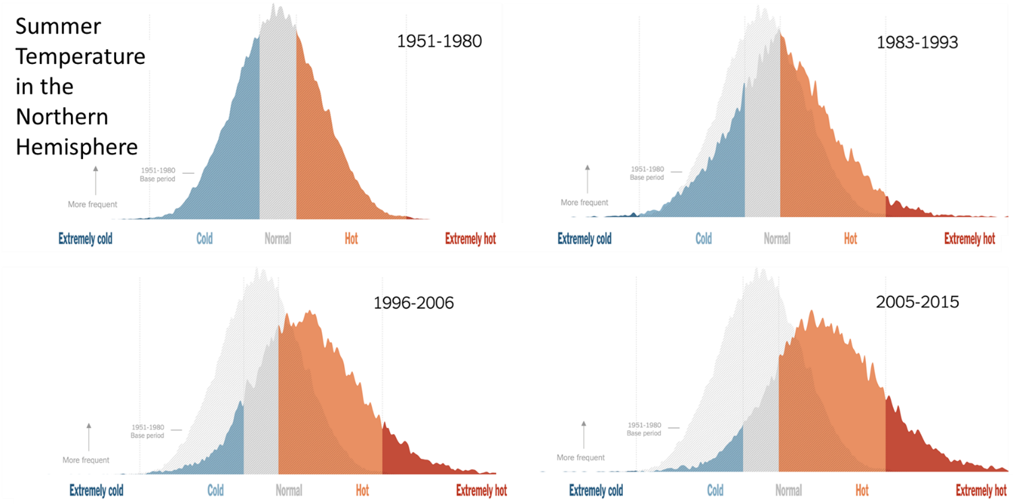
  What do you notice? What do you wonder?
  Summer temperature in the Northern Hemisphere
Notes:
https://www.youcubed.org/wp-content/uploads/2020/09/Dice-Sums-2.pdf

Slide 12

Challenging dogmas
Discuss how the prompts used in the previous slides might help to challenge the following five dogmas associated with learning mathematics identified by Coles & Sinclair (2022).
Start with the first and fourth dogmas.
Maths is a building block subject.
Maths is always right or wrong.
Maths is culture-free.
Maths is for some people, not others.
Maths is hard because it is abstract.
Notes:
Keep the discussion brief.
Note these dogmas were used to devise some of the statements on slide 6.
Note the first and fourth dogmas were felt the most relevant to this workshop, whilst others were felt more appropriate for the other two workshops.
Encourage participants to start with dogmas 1 and 4 before moving onto any of the other three dogmas they feel are relevant.

Slide 13
Classroom activity
You are going to explore the Rock, paper, scissors game.
What do you already know about the game?
‘Rock, paper, scissors’ is one of the oldest hand games in the world, dating back to the Chinese Han Dynasty (206 BCE–220 CE). It is very popular in Japan where it is known as ‘Janken’.
Notes:
This activity is taken from the Primary Mathematics journal (Summer 2024): https://www.m-a.org.uk/primary-maths.
It can be used with primary students, and it can be easily extended to an activity suitable for secondary students (with a greater focus on ‘probability’).
Organise participants into groups of 3 or 4. Make sure everyone knows how to play the game. Get them to try the game several times with others in their group before discussing the questions on the next slide.
Contrast the cultural context with those of the first set of activities.

Slide 14
Rock, paper, scissors
For 2 players competing against each other and 3 actions:
Rock beats Scissors; Scissors beat Paper; Paper beats Rock.
Play the game several times with others in your group.
Then discuss the following questions (making sure that you explain the reasoning behind your answers):
Is it fair? Do both players have the same chance of winning?
Which action (Scissors, Paper or Rock) should you choose?
How many different outcomes are there for each game?
How do you know you have found all the possibilities?
How many outcomes result in you winning/drawing/losing?
What is the chance/probability of winning/drawing/losing?
Is your chance of winning the same in each round?
How could you represent the game in a diagram?
Notes:
Get participants to discuss the questions.
Circulate and encourage them to explain their reasoning.
Get everyone back together and take some ideas for each question (call on anyone you noticed come up with good explanations).
Encourage participants to share their methods/diagrams for showing all outcomes and representing the game (see some suggestions on next slides).
Focus on the reasoning rather than the answers (you could give the answer and then ask why).

Slide 15
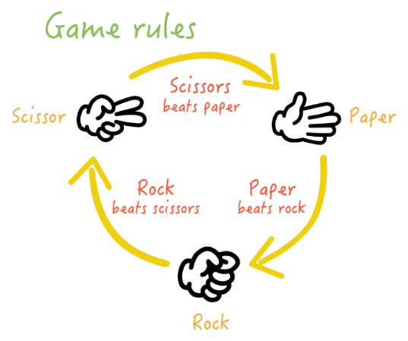
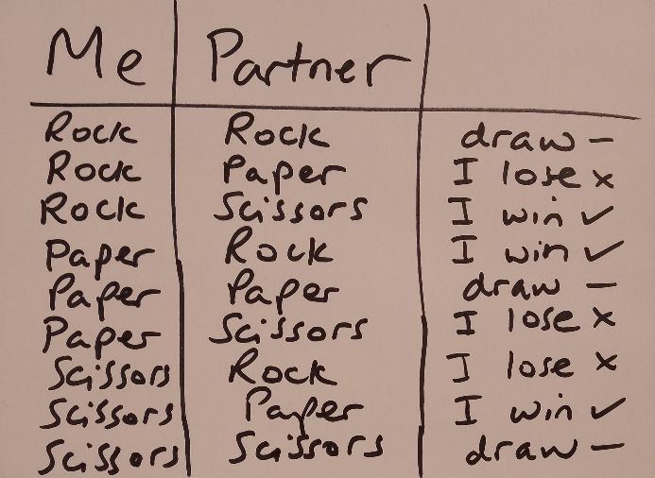
Rock, paper, scissors
For 2 players competing against each other and 3 actions:
Extending the activity:
How could you change the game for 4 players competing against each other? What about 3 players? 5 players?
What would happen if you had more than 3 actions?
What other questions could you ask?
Notes:
Discuss the pros and cons of these representations and compare to participants’ own representations.
Quote from Primary Mathematics journal: Here we are encouraging students to think about issues such as fairness in a systematic way, while engaging in a game that they might be very familiar with.
This game can be developed to include more than 3 actions.
5 actions are looked at on slide 16.
Some questions for reflecting on the activity are proposed on slide 17.
Source for representation: https://andygrunwald.com/blog/playing-rockpaperscissors-with-500-people/
The diagrams on slides 15 and 16 are reproduced in a printable form as Appendix 4 in the facilitators’ notes.

Slide 16
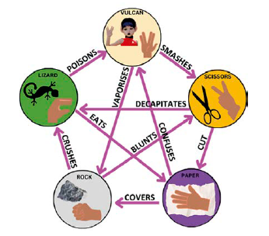
Rock, Paper, Scissors, Lizard, Vulcan
The diagram for the 5 actions game shows the cycles of winning actions and elements: Paper covers Rock, Rock crushes Lizard, Lizard poisons Vulcan, Vulcan smashes Scissors, Scissors decapitate Lizard, Lizard eats Paper, Paper disproves Vulcan, Vulcan vaporizes Rock, Rock crushes Scissors and Scissors cut Paper.
Discuss: Is the game fair?
Notes:
This activity is also taken from the Primary Mathematics journal (Summer 2024): https://www.m-a.org.uk/primary-maths.
You can watch Sheldon explaining the rules to Rock, Paper, Scissors, Lizard, Vulcan (3 times) in the following YouTube clip taken from The Big Bang Theory: https://www.youtube.com/watch?v=x5Q6-wMx-K8

Slide 17
Reflection on ‘Rock, paper, scissors’
Reflect on the activity you have just engaged with:
How many different ways were there to be successful?
Are these different ways of being successful all measurable?
In what ways were you successful in mathematical learning?
What about other people in your group?
To what extent is the activity socially just? Why?
Reflect on which common myths/dogmas are challenged by the approach taken in this activity:
Refer to statements reflecting common myths (on slide 6).
Refer to Coles and Sinclair’s dogmas (on slide 12).
Notes:
Encourage participants to reflect on the inclusive characteristics of the pedagogies modelled and approaches taken.

Slide 18
Reflective discussion
Refer to any notes made relating to the discussion on slide 5.
How has you thinking changed since the start of the workshop.
What strategies can you use as a teacher to promote an inclusive environment within the mathematics classroom?
What are the implications for the development of your future practice?
How might this relate to …?
  Learning activities? Teaching approaches?
  Classroom organisation? Resources?
  Expectations of the whole class/individuals?
Notes:
The aim here is to identify ways in which participants’ thinking has moved on during the session by relating back to the initial discussion (see slide 5).
Encourage participants to refer back to any individual or collective notes that were taken.

Slide 19
A conceptualisation of TMSJ
… four essential elements of mathematics teaching for social justice:
Employ collaborative, discursive, problem-solving, and problem-posing pedagogies which promote mathematical sense-making and the engagement of all learners with mathematics.
Promote mathematical inquiries that resonate with learners’ real-life experiences and that help them develop greater understanding of their social, cultural, political, and economic situations.
Facilitate mathematical investigations that develop learners’ individual and collective agency, enabling them to take part in future social action for the public good.
Challenge common myths surrounding school mathematics, expose processes that lead to the marginalisation of some learners, and open up to scrutiny what it means to be successful.
(Wright, 2024, p. 26)
Discuss how this conceptualisation relates to the activities and pedagogies modelled, and the discussions held, in this workshop.
Notes:
This conceptualisation was presented in the ‘Introduction to TMSJ’ workshop.
It can be a useful summary to take away and prompt future discussions and inform future work.

Slide 20
References
Coles, A. and Sinclair, N. (2022): I Can't Do Maths! Why children say it and how to make a difference. London: Bloomsbury.
Skovsmose, O. & Borba, M. (2004) Research Methodology and Critical Mathematics Education, in P. Valero and R. Zevenbergen (eds.) Researching the Socio-Political Dimensions of Mathematics Education: Issues of Power in Theory and Methodology. Boston, MA: Springer US, pp. 207-226.
UNESCO (2024). What you need to know about inclusion in education. Retrieved from: https://www.unesco.org/en/inclusion-education/need-know
Wright, P. (2024). The mathematics curriculum and concerns for social justice. In T. Cotton, M. K. Jagdev, B. Kaur, & P. Wright, Towards a socially just mathematics curriculum (pp. 19-31). London: Routledge.

