Slide 1

Workshop 2: Socially just approaches to tackling engagement with mathematics
One of a series of professional development workshops on promoting socially just mathematics teaching developed by members of the Teaching Maths for Social Justice Network and freely available via the network’s website: www.mathsocialjustice.org
The development of this workshop was supported by funding from the BERA Small Grant Fund awarded to Pete Wright and a team of co-researchers from the TMSJN.
Notes:
Emphasise that this workshop, and others in the series, are free to download - they are accompanied by detailed/flexible notes for facilitators.

Slide 2
Features of workshop:
Engage with some classroom activities.
Opportunities to talk/discuss/contribute.
Model and discuss pedagogies.
Critically reflect on existing practice.
Question and challenge prior assumptions.
Reflect on constraints/opportunities.
Consider implications for future practice.
Notes:
Outline features of the workshop.

Slide 3
Why is engagement a social justice issue?
Wright, Fejzo & Carvalho (2022) argue that:
“There is some compelling evidence that ‘progressive’ mathematics pedagogy can promote equitable outcomes, whilst enhancing the engagement, enjoyment and conceptual understanding of learners …” (p.445)
“Given Bourdieu’s contention … that working-class students are less likely to accumulate ‘mathematical capital’ and identify themselves as mathematics learners …, increases in students’ engagement with mathematics are seen as essential for addressing the under-performance of disadvantaged students.” (p.458)
Notes:
Invite brief comment on quotes.
Emphasise that these quotes offer a particular perspective to prompt discussion and are not meant to be a definitive answer.
Note the following terms are also considered to relate closely to what we mean by ‘engagement’: motivation, interest, anxiety, emotional responses.

Slide 4
Discussion
What do you think might contribute towards the following characteristics of some learners of mathematics …?
Lack of motivation, interest or enjoyment
Alienation
Disengagement and passivity
Anxiety
In this session we explore some key ideas:
Learners feel that they and their mathematics matter.
We need to build a learning community in the classroom where each is responsible for the achievement of all.
Learning mathematics has meaning and purpose.
Notes:
The rationale here is to capture initial reflections/discussions to provide a ‘starting point’ to draw on during the session and to prompt reflections at the end of the session on how thinking has moved on. Here is one way to facilitate this …Briefly, jot down ideas individually then share in small groups. Place labels for the characteristics across the middle of a board/wall. Keep a record of responses by taking feedback from small groups, one by one, until all groups have exhausted their ideas (don't include repeats).
Invite groups to stick post-it notes above each characteristic (stuck on wall). Leave space below for titles with corresponding positive characteristic (to be added later).
Explain that everyone will reflect on how we might address some of these issues at the end of the session.
Reveal second part of slide and explain that we are going to start by thinking about some activities where everyone matters and everyone needs to work together.

Slide 5

Counting Together
Altogether count to 12.
Repeat with everyone raising
hands on the multiples of 2.
Repeat with multiples of 3.
Repeat again with half the group
raising hands on 2 and half on 3.
Discuss: What do you notice?
Count to 60. This time a third of the group raise hands on multiples of 2, a third on 3, and a third on 5.
Discuss with your neighbour:
How many times did we all raise together?
If we counted in 3s, 4s and 5s, when would we first be altogether?
Relate your discussions to common multiples.
Notes:
There are three relatively short activities in this workshop.
It is important to provide space for discussion/reflection, therefore it might be better to get a feel for each activity rather than attempting to complete them all.
The activities are best suited to students in upper primary or lower secondary (ages 7 to 14).
The first activity is most satisfying when you are standing in a circle where everyone can see everyone else at the same time but, if this is not possible, try to ensure that all participants can see each other.
You might need to facilitate agreement on how to divide the group up into those looking for multiples of 2, 3, 5.

Slide 6

Counting Together
Discuss:
How easy was it to all count together?
Did you get better at it?
How did you feel during the activity?
Why did everyone have to be involved?
This activity and the following activity come from a set of four activities taken from the PiCaM Project’s Mathematical Bodies resource, designed to build a learning group where everybody matters, and everyone has an equal role to play. They offer an embodied experience of multiples and factors, common multiples, primes and co-primes.
Notes:
Reflect on these questions before moving on to the next activity.
Mathematical Bodies resource URL:
http://www.citizenship-and-mathematics.eu/media/en_mathematical_bodies_final.pdf
The four activities are: Making the circle and working together; Exploring common multiples; Jumping numbers; Throwing the wool.

Slide 7
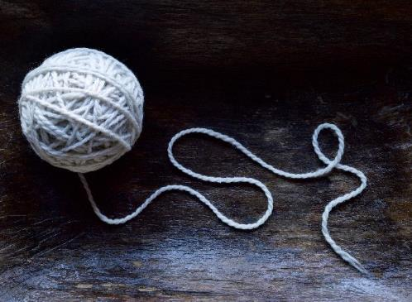
Throwing the String (or Wool)
Sit in a circle so that you can all
see each other clearly.
One person starts with the string.
Count on 3 people clockwise
from where you are standing.
Keep hold of the end of the string
and throw the ball to that person.
Continue until the first person has
the ball back again.
What shape have you made?
Why did the string not go to
everyone?
This activity is taken from the PiCaM ‘Mathematical Bodies’ resource: http://www.citizenship-and-mathematics.eu/media/en_mathematical_bodies_final.pdf
Notes:
You may need to experiment with resources and decide if string or wool is better for this activity.
Make sure the number of people is a multiple of 3 by adding or leaving the group yourself and/or having an observer.
12 is probably the maximum number for this activity.

Slide 8
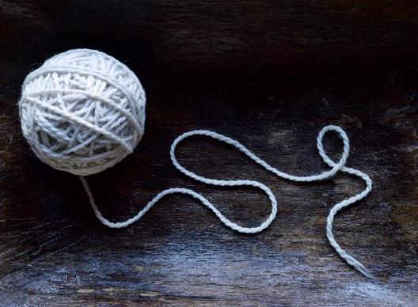
Throwing the String
Discuss:
How can we change the
counting on number so that
everyone gets a turn?
How many different ways can
we do this?
What shapes can we make?
What conjectures can we make?
How can we test them?
How can we explain them?
Notes:
These questions are part of the ‘Throwing the String’ activity.
Encourage the group to describe geometric properties in detail.
Think carefully about language used – how can you acknowledge/respect everyday language used whilst introducing more formalised/abstract/powerful language?
Use prompt questions if needed: Number of sides? Line symmetry? Rotational symmetry? Regular? What type of angles? Size of angles? Shapes inside the shape? What type of triangles/quadrilaterals/etc?
Ask people to argue for their conjectures. Emphasise how important conjecturing (coming up with plausible ideas) is in mathematics and that conjectures that turn out to be false can be useful in developing our thinking.
If agreement isn’t reached, conjectures can be tested by further throwing of the string with follow-up discussion.
If there is time, extend the activity with other numbers of players – further conjectures can be made and tested.

Slide 9


‘Counting Together’ and ‘Throwing the String’
What are the pedagogic opportunities and challenges for these two activities?
To what extent are the activities socially just? Why?
Notes:
These questions provide an opportunity to discuss the pedagogies that have been modelled in the two activities.
Prompts for discussion might include:
How did you feel taking part in this mathematical activity?
What strategies showed that everyone mattered?
What strategies were used to establish a community of learners?
What strategies were used to encourage cooperative learning?
How might you manage taking suggestions from the learners about their conjectures?
How might you record the activity? Chalk on the floor/outside?
How does recording tasks as a class differ from individuals keeping notes/records?
How did the ‘teacher’ deal with language during the activity?
How would you use this activity in your practice?
What might the impact be on learners’ engagement?

Slide 10

Challenging dogmas
Discuss how the activities used so far in this workshop might help to challenge the following five dogmas associated with learning mathematics identified by Coles & Sinclair (2022).
Start with the second dogma.
Maths is a building block subject.
Maths is always right or wrong.
Maths is culture-free.
Maths is for some people, not others.
Maths is hard because it is abstract.
Notes:
Relate the discussion of dogmas back to the previous discussions.
Note the second dogma was felt the most relevant to this workshop, whilst others were felt more appropriate for the other two workshops.
Encourage participants to start with dogma 2 before moving onto any of the other four dogmas they feel are relevant.

Slide 11
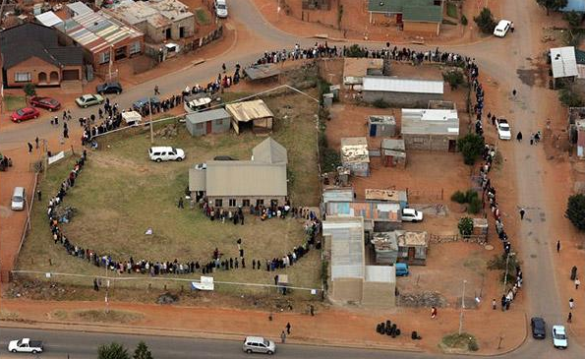
  How many people?
  Estimate the number of people waiting in the queue to vote …
Democratic elections in South Africa (after the end of Apartheid in 1994)
Credit: AFP/GETTY
Notes:
This activity focuses on the third key idea, i.e. learning mathematics has meaning and purpose.
Work initially in small groups.
To enhance visibility/accessibility (and to allow annotation), print off one copy of the slide/photo for each group (included as Appendix 1 of facilitators’ notes).
Encourage people to discuss their strategies for estimating the number of people with each other – discourage them from trying to count accurately.
Circulate and model using prompt questions such as:
What experiences do you have of queuing?
What strategies would you use/have you used?
Could you create your own queue now with fellow learners to help?
What assumptions have you made/do you need to make?
Do you think everybody in the picture is waiting to vote?
What would be a reasonable level of accuracy?
Is your estimate an over-estimate or an under-estimate? Why?
Why might you need to estimate the number of people waiting to vote?

Slide 12
How many people?
Discuss the following in your groups:
What mathematics is involved in this activity?
Does the actual number of people in the queue matter?
What other questions could you ask related to this picture?
Discuss the following questions as a larger group:
What is mathematics?
What is the purpose of mathematics?
Notes:
Discuss in small groups then take feedback.
Encourage participants to generate their own (mathematical) questions to explore. For example:
How long would it take everyone in the queue to vote?
How many people might vote over the course of a day?
How many voting stations might be needed altogether?
The final discussion is an opportunity to challenge myths and discourses around mathematics.
Focus on modelling and problem-solving skills (making assumptions, generating a model, interpreting the findings) as well as commonly held views around curriculum content.
Discuss why you might want to make the mathematics (in its wider sense) more explicit to learners.
Participants might distinguish between what (the purpose of) maths is now, what it should be, and what it would be in a socially just curriculum.
Encourage participants to consider how they could relate the activity to learners’ real lives experiences (in a meaningful rather than a tokenistic way).

Slide 13
How many people?
What are the pedagogic opportunities and challenges for this activity?
To what extent is the activity socially just? Why?
Notes:
Discuss the pedagogic rationale for the activity
Further prompts might include:
How did you feel taking part in this mathematical activity?
What strategies were used to show that everyone mattered?
What strategies were used to establish a community of learners?
What strategies were used to encourage cooperative learning?
How might you manage a classroom in which students pose their own questions?
How might you choose which one(s) to explore? How might you manage a vote?
How would you use this activity in your practice?
What might be the impact on learners’ engagement?
What other photographs could be used as a prompt?
What questions might you ask?
Relate to the commonly used questions: What do you see? What do you think? What do you wonder?

Slide 14
Estimation
Discuss the following:
How and why do we estimate the number of anything?
Can you think of an example where all we can do is estimate?
When might it matter if our estimate was wildly out?
Can you think of examples where we (or other people)
might deliberately under or over-estimate?
Notes:
These prompts provide a good opportunity to challenge myths and discourses around mathematics, including the commonly held belief that mathematics is neutral and value free.
This relates to Coles and Sinclair’s third dogma: Maths is culture-free (see slide 10).

Slide 15
Reflective discussion
What strategies can you use as a teacher to encourage the following characteristics for all learners of mathematics …?
Motivated to learn, interested in and enjoying mathematics.
Identifying as a mathematics learner and feeling that the mathematics matters.
Highly engaged and active during lessons.
Confident as a mathematics learner.
Reflect on the key ideas we set out to explore in this workshop:
Learners feel that they and their mathematics matter.
We need to build a learning community in the classroom where each is responsible for the achievement of all.
Learning mathematics has meaning and purpose.
What are the implications for developing your practice?
Notes:
The rationale here is to identify ways in which participants’ thinking has moved on during the session by relating back to the initial discussion [see current slide 4]. Here is one way to facilitate this …
Put the labels for the positive characteristics below those already on board/wall.
Invite participants to stick post-it notes under each characteristic.
Compare responses to responses from earlier discussions.
Reflect on the key ideas outlined at the start of the workshop.
For experienced teachers, you might want to prompt discussions around constraints teachers might face in implementing ideas from the workshop, and how these might be overcome.

Slide 16
A conceptualisation of TMSJ
… four essential elements of mathematics teaching for social justice:
Employ collaborative, discursive, problem-solving, and problem-posing pedagogies which promote mathematical sense-making and the engagement of all learners with mathematics.
Promote mathematical inquiries that resonate with learners’ real-life experiences and that help them develop greater understanding of their social, cultural, political, and economic situations.
Facilitate mathematical investigations that develop learners’ individual and collective agency, enabling them to take part in future social action for the public good.
Challenge common myths surrounding school mathematics, expose processes that lead to the marginalisation of some learners, and open up to scrutiny what it means to be successful.
(Wright, 2024, p. 26)
Discuss how this conceptualisation relates to the activities and pedagogies modelled, and the discussions held, in this workshop.
Notes:
This conceptualisation was presented in the ‘Introduction to TMSJ’ workshop.
It can be a useful summary to take away and prompt future discussions and inform future work.

Slide 17
References
Coles, A. and Sinclair, N. (2022): I Can't Do Maths! Why children say it and how to make a difference. London: Bloomsbury.
Project in Citizenship and Mathematics (PiCaM) website:
http://www.citizenship-and-mathematics.eu
PiCaM (2019): Mathematical Bodies. Accessed from http://www.citizenship-and-mathematics.eu/media/en_mathematical_bodies_final.pdf
Wright, P. (2024). The mathematics curriculum and concerns for social justice.
In T. Cotton, M. K. Jagdev, B. Kaur, & P. Wright, Towards a socially just mathematics curriculum (pp. 19-31). London: Routledge.
Wright, P., Fejzo, A. & Carvalho, T. (2022). Challenging inequity in mathematics education by making pedagogy more visible to learners. International Journal of Mathematical Education in Science and Technology, 53(2), pp. 444-466. https://doi.org/10.1080/0020739X.2020.1775320

