Slide 1

Workshop 3: Socially just approaches to problem solving in mathematics
One of a series of professional development workshops on promoting socially just mathematics teaching developed by members of the Teaching Maths for Social Justice Network and freely available via the network’s website: www.mathsocialjustice.org
The development of this workshop was supported by funding from the BERA Small Grant Fund awarded to Pete Wright and a team of co-researchers from the TMSJN.
Notes:
Emphasise that this workshop, and others in the series, are free to download - they are accompanied by detailed/flexible notes for facilitators.

Slide 2
Features of workshop:
Engage with some classroom activities.
Opportunities to talk/discuss/contribute.
Model and discuss pedagogies.
Critically reflect on existing practice.
Question and challenge prior assumptions.
Reflect on constraints/opportunities.
Consider implications for future practice.
Notes:
Outline features of the workshop.

Slide 3
Discussion
What do you understand by problem solving in school mathematics?
Which pedagogies/teaching approaches would you expect to see in a problem-solving maths lesson?
How much problem-solving are you likely to see
in a ‘typical’ mathematics lesson?
What has problem solving in school mathematics got to do with social justice?
Record some of your ideas for later reflection.
Notes:
Encourage participants to write down their own ideas first, then take some feedback.
Keep discussion brief (5 minutes or so), just as a 'warm up’.
The reflective discussion on slide 18 will encourage participants to refer back to the notes they record here.
Note the following terms are also considered to relate closely to what we mean by ‘problem solving’: real world contexts, investigations, modelling, meaningful experiences, problem posing.

Slide 4
Reading and writing the world with mathematics:
Gutstein (2006) argues that:
“For me, reading the world with mathematics means to use mathematics to understand relations of power, resource inequities, … disparate opportunities between different social groups … explicit discrimination based on race, class, gender, language, and other differences … it means to dissect and deconstruct media and other forms of representation … to use mathematics to examine these various phenomena both in one’s immediate life and in the broader social world and to identify relationships and make connections between them.” (p.25)
“Writing the world with mathematics means using mathematics to change the world.” (p.27)
Notes:
Invite individual comments on the quotes.
Keep the discussion brief – enough to highlight key ideas.
Emphasise that these quotes offer a particular perspective to prompt discussion and are not meant to be a definitive answer.

Slide 5
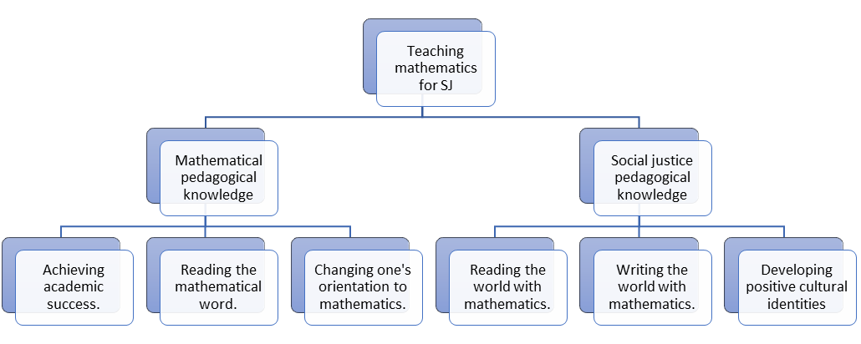
Gutstein’s (2006) framework for TMSJ
Discuss: How do Gutstein’s quote (previous slide), and the framework below, compare to your initial ideas about mathematics, problem solving and social justice?
(Kaur, 2024 based on Gutstein, 2006)
Notes:
Discuss in small groups then take some feedback.
This framework will be used to reflect on the activities presented in this workshop.

Slide 6
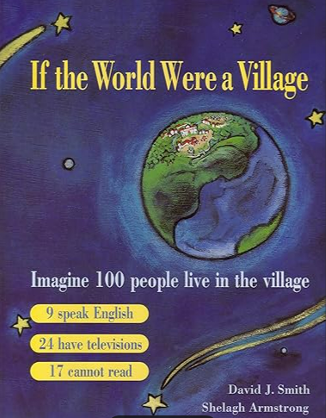
Activity 1: If the world were a village:
Nrich activity:
This activity is based on data in the book 'If the World Were a Village’. How will you represent your chosen data for maximum effect?
In the book, the world’s population (6.7 billion) is represented in the imaginary village of 100 residents so that each resident represents approximately 67 million people from the real world.
Notes:
This activity was designed for use with primary students, although it can be easily extended for use with secondary students.
We suggest that you use this activity to highlight the different ways that ‘problem solving’ could be interpreted/approached:
In a closed, procedural way (initially) – is this really ‘problem solving’?
Followed up with an approach highlighting how many of the TMSJ principles could be incorporated.
If you have the book, you could choose one double-page spread as an example to share.
Introduce the idea as presented in the Nrich activity (text in left hand column): https://nrich.maths.org/problems/if-world-were-village

Slide 7
Where do people in the village come from?
In the village, 61 people are from Asia; 13 are from Africa; 12 are from Europe; 8 are from South America, Central America and the Caribbean; 5 are from Canada and United States; 1 is from Oceania.
Which region has the largest/smallest population?
What proportion come from Asia/Africa/Europe?
Discuss: What other questions could you ask?
Region | Population
Asia | 61
Africa | 13
Europe | 12
South America, Central America and the Caribbean | 8
Canada and United States | 5
Oceania | 1
Is this really ‘problem solving’?
Notes:
You could ask questions about percentages, more than/less than, ratios.
Note that all of these questions are closed and could be answered without really engaging with the context.
This is what some people consider to be ‘problem solving’. However, from Gutstein’s social justice perspective, this is not ‘problem solving’.
Questions that might lead to socially-just problem solving include:
Does this surprise you? Why do you think this is the case?
The focus now moves on to more socially just approaches to problem solving.

Slide 8


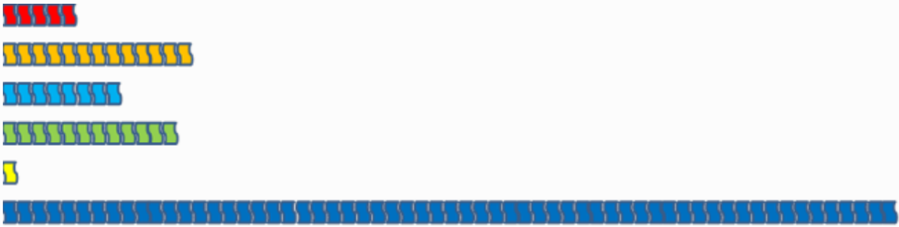
  Where do people in the village come from?
  How will you represent this data for maximum effect?
  Give reasons for your answers
Region | Population
Asia | 61
Africa | 13
Europe | 12
South America, Central America and the Caribbean | 8
Canada and United States | 5
Oceania | 1
Like this …?
… or like this …?
… or like this …?
… or a different way?
Notes:
There is a printable version of this slide in Appendix 1 of the facilitators’ notes.
Get participants to have a go at this activity in small groups. Encourage collaboration and discussion.
Here are the accompanying questions from the Nrich task:
What do you think? All of them show exactly the same information.
Which representation makes you realise that there are 100 people?
Which one makes you realise that there are LOADS more people from Asia than anywhere else?
Which was easiest to count? Did you notice how a flag had been used because that was linked to the topic?
The following video provides a useful way of introducing the activity: https://www.youtube.com/watch?v=A3nllBT9ACg

Slide 9
Some more ideas from the Nrich activity
Task: A gallery based on the book 'If the World Were a Village' has opened and needs some exhibits. Your challenge will be to decide how to represent some more of the data from the book. Here are some suggestions …
Electricity:
In the village, 76 people have electricity; 24 do not.
The people with electricity have between them: 42 radios, 25 televisions, 61 telephones and 15 computers.
Air and Water:
In the village, 82 people have access to a source of safe water either in their homes or within a short distance; 18 do not and must spend a large part of each day simply getting safe water. Most of the work of collecting water is done by women and girls.
64 people have access to adequate sanitation - they have public or household sewage disposal - while 36 do not.
68 breathe clean air; 32 breathe air that is unhealthy due to pollution.
Notes:
Discuss how this approach is different to the closed questions on slide 7.

Slide 10
Teachers’ notes accompanying Nrich activity
Includes guidance on the rationale and a possible approach.
Possible extension: Children could collate their own information from their class or school and represent this. This could tie in with other class topics. For example, from our class: How many TVs/cars do we own? What do you read before going to sleep? How long do you spend learning your spellings? How many people live in your house?
Possible support: Children may need to see various representations in order to feel confident to create their own. Encourage children to make changes - it's easy to change back! Encourage children to consider whether their representation is fair, whether what they've chosen to use is suitable.
Key questions:
What does this data show?
What does this tell us?
What do you think about that?
How is this different from ...?
If you were in the village, where would you be?
How many more/less ...?
Approximately how many is this?
How will you represent this information?
Is there another way?
Is this the clearest way for someone visiting the gallery?
Notes:
Discuss how you might use/adapt this approach with your own students.
Other ideas for developing the activity include:
Prompt a discussion around equality and inequality
Consider how to write the numbers 6.7 billion and 67 million
The population has since increased – what is it now?
A class is normally around 30 children – relate the proportion of the village (percentages) to the equivalent proportion of the class (imagine a village of 30 people).
Further ideas available in Cotton, Jagdev, Kaur & Wright (2024): Towards a socially just mathematics curriculum (see page 99).
How else might you adapt the task for use with secondary school students?
You might want to discuss the cultural sensitivity of some of the questions, e.g. asking about owning TVs/cars may be seen as promoting a consumerist culture.

Slide 11
Reflect on ‘If the world were a village’ activity
Discuss how the activity relates to Gutstein’s (2006) framework for TMSJ:
Does the framework offer any suggestions/guidance on how you might develop the activity?
To what extent is the activity socially just? Why?
Notes:
Discuss in small groups and then as a whole group.

Slide 12

Challenging dogmas
Discuss how the first activity might help to challenge the following five dogmas associated with learning mathematics identified by Coles & Sinclair (2022).
Start with the third and fifth dogmas.
Maths is a building block subject.
Maths is always right or wrong.
Maths is culture-free.
Maths is for some people, not others.
Maths is hard because it is abstract.
Notes:
Relate back to the previous discussions.
Note the third and fifth dogmas were felt the most relevant to this workshop, whilst others were felt more appropriate for the other two workshops.
Encourage participants to start with dogmas 3 and 5 before moving onto any of the other three dogmas they feel are relevant.

Slide 13
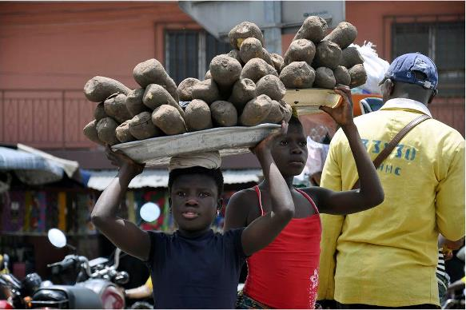
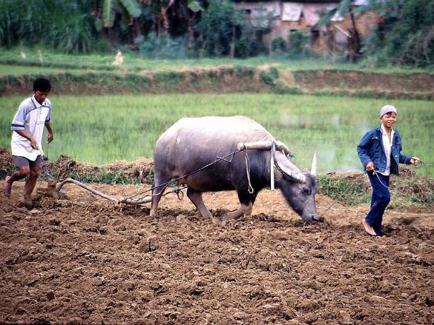
  Activity 2: Exploring child labour
Photo by Degan Gabin, licence: CC BY-SA 4.0
Discuss:
What do you understand by ‘child labour’?
Photo by Thomas Schoch, licence: CC BY-SA 2.5
Notes:
This activity looks at how students can be encouraged to explore a social justice issue through adopting a problem-solving approach.
The reflection will focus on the problem-solving approach.
The way the activity is presented is more suitable for secondary age students, however the approach can be adapted for primary students and other social justice issues can be used as a focus.
We have chosen ‘child labour’ as it is easily relatable to students’ own lived experiences.
The UNICEF report provides a useful starting prompt: https://www.ilo.org/sites/default/files/wcmsp5/groups/public/@ed_norm/@ipec/documents/publication/wcms_797515.pdf
The discussion on this slide would be informed by the facilitator being familiar with the UNICEF report – you could relate the discussion to the meaning assigned to ‘child labour’ in the report, e.g. you might consider exemptions (such as domestic chores) – emphasise the subjective nature of the definition.
You could also show some of the images from the report.
The report (p.18) defines ‘child labour’ as “work that children are too young to perform and/or work that, by its nature or circumstances, is likely to harm children’s health, safety or morals”. It goes on to provide more technical definitions.
It may be worth highlighting how child labour is a worldwide issue (whilst the pictures illustrate only African and Asian contexts) - you could highlight ‘Western’ contexts such as the extent to which child actors might be considered as exploited in the visual media.

Slide 14
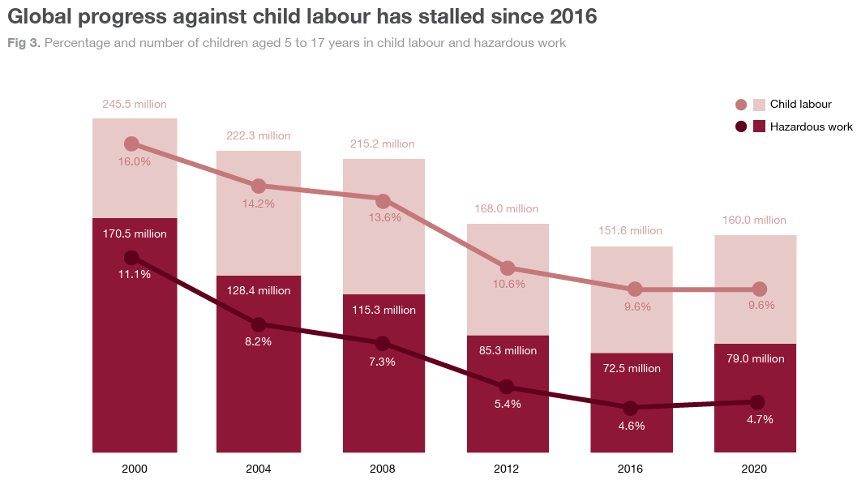
  Discussion prompts
  What do you notice about the graphs?
  What other headlines could you suggest?
  What questions do you have about the data?
  Source: Child Labour report (ILO, UNICEF, 2021)
Notes:
There is a printable version of this slide in Appendix 2 of the facilitators’ notes.
Encourage participants to describe the features of the graphs (line graphs/bar charts/numerical data.
Describe any interesting features, e.g. percentage of children in labour remains at 9.6% between 2016 and 2020 and yet number increases (why?)
Prompt questions for discussion:
Is this headline justified? Why?
Why do you think the data has been presented in this way?
Describe the mathematical features of the graphs? (scales, points, bars)
How are the lines related to the bars?
How else could the data have been presented?
Could different presentations lead to different conclusions?
Encourage a critical understanding by asking questions about the data:
What counts as ‘hazardous’?
How do people measure how many children are working?
How do people know how many children there are altogether?
How is a value for a given year arrived at? Averages?
Could you estimate the percentages/numbers in 4/8/12/16/20 years’ time? Give reasons for your estimates.
How confident are you that your prediction will come true? What would you need to know to be more confident?
Here are some other headlines suggested in the ILO/UNICEF report:
Child labour remains a persistent problem in the world today.
Global progress against child labour has stagnated since 2016.
The global picture masks continued progress against child labour in Asia and the Pacific, and Latin America and the Caribbean.
Continued progress was registered over the last four years among children aged 12 to 14 and 15 to 17.
The COVID-19 crisis threatens to further erode global progress against child labour unless urgent mitigation measures are taken.
Involvement in child labour is higher for boys than girls at all ages.
Child labour is much more common in rural areas.
Most child labour – for boys and girls alike – continues to occur in agriculture.
The largest share of child labour takes place within families.
Child labour is frequently associated with children being out of school.

Slide 15
Next steps
What questions could you ask about child labour?
Which questions are likely to be most productive?
Which questions would be most interesting to you?
How do the questions relate to your own experiences?
What data would you need to answer these questions?
How would you collect/analyse/present this data?
How could you use mathematics to understand child labour and support an argument for change?
Notes:
Encourage participants to think about how they would answer these questions.
Then discuss how they would use these questions with their students.
What is the rationale behind each question?
What challenges are involved in using them in the classroom?
How could you draw links between child labour worldwide and students’ own experiences?

Slide 16
A problem-solving approach to exploring a social justice issue using mathematics
Choose an issue of potential interest to students.
Use a prompt/hook to engage students’ interest.
Cultivate students’ agency in exploring the issue.
Encourage students to pose their own questions and follow their own lines of inquiry.
Encourage critical reflection on how data is collected, presented and interpreted.
Identify strong, genuine and meaningful links between the issue and mathematical ideas.
Encourage students to use maths to understand the issue and support an argument for change.
Notes:
Discuss how this approach has been modelled during the second activity.
This provides an opportunity to discuss any concerns participants might have about tackling ‘controversial issues’ in the mathematics classroom.
There is a useful guide from Oxfam which might inform such a discussion: https://policy-practice.oxfam.org/resources/teaching-controversial-issues-a-guide-for-teachers-620473/
Whilst many teachers of mathematics may lack confidence in tackling controversial issues, it is important to encourage them not to shy away from doing so (otherwise the myth that mathematics is culture-free may be compounded).
The TMSJN website includes two activities (Community in the classroom, Growth in earnings) that provide examples of how to facilitate exploring social justice issues: https://mathsocialjustice.org/activities/

Slide 17
Reflect on ‘Exploring child labour’ activity
Discuss how the activity relates to Gutstein’s (2006) framework for TMSJ:
Does the framework offer any suggestions/guidance on how you might develop the activity?
To what extent is the activity socially just? Why?
Notes:
Discuss in small groups and then as a whole group.
There is likely to be debate around the distinction between ‘reading’ and ‘writing’ the world with mathematics and the challenges involved in translating ideas around social justice into classroom actions.
Gutstein’s research demonstrates ways in which it is possible to do so.

Slide 18
Reflective discussion
What do you understand by problem solving in school mathematics?
Which pedagogies/teaching approaches would you expect to see in a problem-solving maths lesson?
What has problem solving in school mathematics got to do with social justice?
How has your thinking changed since the start of the workshop?
How might you go about implementing these ideas in the mathematics classroom?
What constraints might you face?
What opportunities are there?
Notes:
The aim here is to identify ways in which participants’ thinking has moved on during the session by relating back to the initial discussion [see slide 3].
Encourage participants to refer back to any individual or collective notes that were taken.

Slide 19
A conceptualisation of TMSJ
… four essential elements of mathematics teaching for social justice:
Employ collaborative, discursive, problem-solving, and problem-posing pedagogies which promote mathematical sense-making and the engagement of all learners with mathematics.
Promote mathematical inquiries that resonate with learners’ real-life experiences and that help them develop greater understanding of their social, cultural, political, and economic situations.
Facilitate mathematical investigations that develop learners’ individual and collective agency, enabling them to take part in future social action for the public good.
Challenge common myths surrounding school mathematics, expose processes that lead to the marginalisation of some learners, and open up to scrutiny what it means to be successful.
(Wright, 2024, p. 26)
Discuss how this conceptualisation relates to Gutstein’s framework, and to the activities and pedagogies discussed in this workshop.
Notes:
This conceptualisation was presented in the ‘Introduction to TMSJ’ workshop.
It can be a useful summary to take away and prompt future discussions and inform future work.

Slide 20
References
Gutstein, E. (2006). Reading and writing the world with mathematics: Towards a pedagogy of social justice. New York: Routledge.
International Labour Organization & United Nations Children’s Fund (ILO & UNICEF, 2021). Child labour: Global estimates 2020, trends and the road forward. Report. https://www.ilo.org/sites/default/files/wcmsp5/groups/public/@ed_norm/@ipec/documents/publication/wcms_797515.pdf
Smith, D. & Armstrong, S. (2020). If the world were a village of 100 people. London: Kinds Can Press (3rd Edition).
Wright, P. (2024). The mathematics curriculum and concerns for social justice. In T. Cotton, M. K. Jagdev, B. Kaur, & P. Wright, Towards a socially just mathematics curriculum (pp. 19-31). London: Routledge.

