Slide 1

Workshop: An introduction to teaching mathematics for social justice
One of a series of professional development workshops developed by members of the Teaching Maths for Social Justice Network and freely available via the network’s website: www.mathsocialjustice.org
The development of this workshop was supported by the
International Society for Design and Development in Education through the 2024 ISDDE Prize awarded to Pete Wright (TMSJN Convenor).
Notes:
Explain background to resources and where they can be found.

Slide 2
Features of workshop:
Engage with some classroom activities.
Opportunities to talk/discuss/contribute.
Model and discuss pedagogies.
Critically reflect on existing practice.
Question and challenge prior assumptions.
Reflect on constraints/opportunities.
Consider implications for future practice.
Notes:
Outline features of the workshop.

Slide 3
Discuss:
What has social justice got to do with teaching mathematics?
Record some of your ideas for later.
Notes:
Encourage participants to reflect on current thinking.
Ensure that they record their ideas to refer back to at the end of the session.

Slide 4
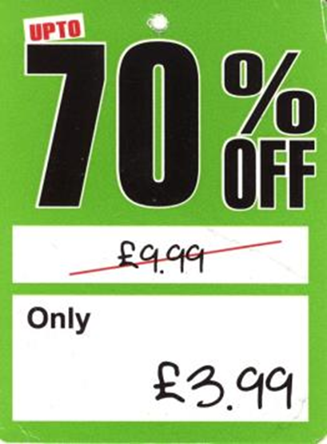
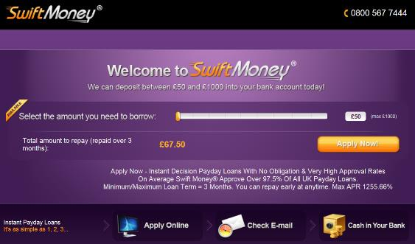

Discussion prompt :
Notes:
Show participants the two discussion prompts [slide 4].
The first prompt is a scan of a real label from a Sports Direct store.
The second prompt is a screen capture from a real website advertisement.
You might have to read aloud some of the small writing in the second ‘Swift Money’ prompt (the key piece of information in the ‘small print’ has been enlarged).
Ask participants what they notice and what they think this has to do with mathematics and social justice.
Specific mathematical questions for prompt 1: Approximately what percentage has this item been discounted by? How do you know?
Specific mathematical question for prompt 2: If you borrow £50 and can’t pay any of it back for one year, how much would you repay altogether? (note APR = Annual Percentage Rate = amount of interest you pay if you pay everything back after one year)
Possible follow-up questions: Is there anything factually incorrect? How is the information misleading? How is this problematic? What kind of mathematical understanding would prevent people from being ‘taken in’ by such information?
The key point to come out of this discussion is that a critical mathematical understanding can prevent people from being misled.
Additional prompt (if needed) - The following (4 minute) video ‘How statistics can be misleading’ outlines how Simpson’s Paradox can lead to incorrect conclusions being drawn from data:
https://www.youtube.com/watch?v=sxYrzzy3cq8

Slide 5
Classroom activity
Choose one or other of:
Making a fair choice (primary oriented)
  see slides 6 to 8
Counting the votes (secondary oriented)
  see slides 9 to 11
Note both activities are based on ideas from:
Towards a socially just mathematics curriculum
(Cotton, Jagdev, Kaur & Wright, 2024).
Notes:
Choose one or other of the activities depending on the composition of your audience.
You won’t have time to do both activities (which would lead to duplication of ideas).
‘Making a fair choice’ is targeted mainly at primary school students.
‘Counting the votes’ is targeted mainly at secondary school students.

Slide 6
Making a fair choice (1)
Yaline, Brad and Rosa are deciding which game to play together.
They are given 6 counters each and asked to use these to vote.
Yaline’s counters are yellow, Brad’s are blue and Rosa’s are red.
Here’s how they voted:
Discuss: Which game should they play? Why?
Scrabble
Cluedo
Ker-plunk
Notes:
Allow participants to discuss the initial prompt [slide 6] in pairs/small groups before inviting feedback.
Once one outcome has been suggested and justified, ask whether other outcomes can be justified – it should be possible to argue for each of the three games.
Encourage participants to give reasons for their ideas [slides 6/7] .

Slide 7
Making a fair choice (2)
Discuss the following in groups:
What is the fairest way of making a choice using counters?
How many counters should each person (or group) have?
How should they allocate them to different options?
How should the results be used to make a decision?
Try out some of your ideas.
Option 3
Option 1
Option 4
Option 2
Notes:
Divide participants into small groups of 3 to 4 to discuss the second prompt [slide 7].
Circulate to pose prompt questions to facilitate discussions and to identify ‘good ideas’ to call upon during feedback discussion.
Invite one person from each group to feedback ideas from their group’s discussion.
Build on people’s ideas, make connections between them and refer back to ideas using the contributor’s name (i.e. ‘X’s idea’) or the names of the contributing group.
Further prompts (if needed) might include [slides 6 and 7]:
Which should be given greater weight: first/second/third preferences?
Is it OK for students to allocate their counters using different methods?
Should there be only one ‘winner’ in this case?
Should students’ counters be identifiable?
Appendix 1 (in the facilitators’ notes document) could be used by students to try out their ideas in a different context.

Slide 8

Making a fair choice (3)
When electing their Members of Parliament in the UK, voters get to place an ‘x’ next to their preferred choice:
Discuss: How fair is this voting system?
Notes:
Compare discussion to current method for electing MPs.
Check understanding by asking: This is like every voter having how many counters?
Further prompts (if needed) might include:
What is meant by ‘fair’?
How would only having one counter limit your choice?

Slide 9
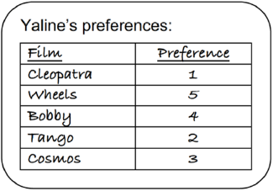
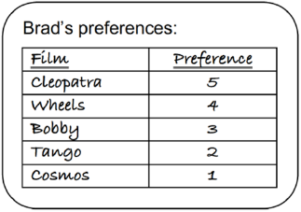
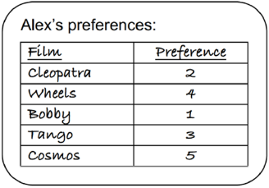
Counting the votes (1)
Imagine that three friends, Yaline, Brad and Alex, are going to the cinema together, but they can’t agree which film to see.
They decide to write down their preferences:
‘1’ for their first-choice film, ‘2’ for their second-choice film, etc.
Discuss: Which film should they see? Why?
Notes:
Allow participants to discuss the initial prompt [slide 9] in pairs/small groups before inviting feedback.
Appendix 2 (in the facilitators’ notes document) can be used to provide a more accessible prompt for discussion.
Once one outcome has been suggested and justified, ask whether other outcomes can be justified – it should be possible to argue for each of Cleopatra, Bobby, Tango.
Encourage participants to give reasons for their ideas [slides 9 to 11].

Slide 10
Counting the votes (2)
Jean-Charles de Borda (1733-1799) designed two preferential voting
systems using different sequences that are still in use today:
The Borda count with arithmetic weighting uses 1, 2, 3, 4, 5, …
The Borda count with geometric weighting uses 1, 2, 4, 8, 16, …
Points are awarded as follows (assuming there are 5 choices):
Each first preference is awarded the 5th term in the sequence (5 or 16)
Each second preferences is awarded the 4th term in the sequence (4 or 8)
  … and so on until …
Each fifth preference is awarded the 1st term in the sequence (1).
The winner has the greatest total when the points are added together.
Discuss: Which film will be chosen using each of these Borda counts?
Notes:
Invite participants to read about the Borda count.
Check understanding by asking questions such as:
How many points will Cosmos be awarded altogether under the Borda count with arithmetic weighting? … geometric weighting?
How many points would be awarded for a first preference if there were 6 choices … under the Borda count with arithmetic weighting? … geometric weighting?
Which method gives greater weighting to first/second/third preferences?
What would happen if no fourth/fifth preference was expressed?
Invite participants to check which films are chosen using the Borda count with arithmetic and weighting. Check for consensus and confidence (without giving answer).

Slide 11
Counting the votes (3)
Jean-Charles de Borda (1733-1799) designed two preferential voting systems using different sequences that are still in use today:
The Borda count with arithmetic weighting uses 1, 2, 3, 4, 5, …
The Borda count with geometric weighting uses 1, 2, 4, 8, 16, …
Points are awarded as follows (assuming there are 5 choices):
Each first preference is awarded the 5th term in the sequence (5 or 16)
Each second preferences is awarded the 4th term in the sequence (4 or 8)
  … and so on until …
Each fifth preference is awarded the 1st term in the sequence (1).
The winner has the greatest total when the points are added together.
Discuss the following in groups:
How fair is each of the Borda counts?
Can you come up with a fairer system by using a different sequence?
Try out some of your ideas.
Notes:
Divide participants into small groups of 3 to 4 to discuss the second prompt.
Circulate to pose prompt questions to facilitate discussions and to identify ‘good ideas’ to call upon during feedback discussion.
Invite one person from each group to feedback ideas from their group’s discussion.
Build on people’s ideas, make connections between them and refer back to ideas using the contributor’s name (i.e. ‘X’s idea’) or the names of the contributing group.
Further prompts (if needed) might include [slides 10 and 11]:
Does it make any difference what the first term in the sequence is?
What about the common difference/ratio?
Which preferences should be given greater weighting?
Which type of sequences would facilitate this?
Compare discussion of ideas to the Borda count methods.
Further prompts (if needed) might include:
What is meant by ‘fair’ and ‘fairer’?
How easy would it be to apply each sequence?
Appendix 3 (in the facilitators’ notes document) could be used by students to try out their ideas in a different context.

Slide 12
Discussion of activity:
Reflect on the pedagogies modelled and/or employed during the classroom activity.
How could you use this classroom activity or related ideas with students?
What maths would children be learning?
What would children be learning about fairness and social justice?
Notes:
Reflect on the pedagogies modelled/employed during the activity [slide 12] including:
Questioning rather than explaining.
Facilitating group work and discussion.
Attributing ideas to individuals or groups.
Encouraging justification and argumentation.
Providing open-ended prompts with multiple solutions.
Establishing strong links between mathematical ideas and social justice issues.
Encourage participants to consider how they would adapt the classroom activity to their own situation [slide 12].

Slide 13
A conceptualisation of TMSJ
… four essential elements of mathematics teaching for social justice:
Employ collaborative, discursive, problem-solving, and problem-posing pedagogies which promote mathematical sense-making and the engagement of all learners with mathematics.
Promote mathematical inquiries that resonate with learners’ real-life experiences and that help them develop greater understanding of their social, cultural, political, and economic situations.
Facilitate mathematical investigations that develop learners’ individual and collective agency, enabling them to take part in future social action for the public good.
Challenge common myths surrounding school mathematics, expose processes that lead to the marginalisation of some learners, and open up to scrutiny what it means to be successful.
(Wright, 2024, p. 26)
Discuss how the conceptualisation relates to the classroom activity.
Notes:
Present the conceptualisation of TMSJ [slide 13].
Appendix 4 (in the facilitators’ notes document) can be used to provide a more accessible prompt for discussion.
This is taken from one of Pete’s chapters in the recently published book: Towards a socially just mathematics curriculum [see reference on slide 17].
Ask for comments using the following as prompt questions (if needed):
Is there anything there that surprises you … reassures you?
Does this resonate with any other theories/reading you have encountered?
You could ask participants to consider the final question in pairs/small groups before feeding back:
Discuss how the conceptualisation relates to the classroom activity.
The following points might come up in the discussion:
- The first element resonates with the pedagogies modelled during the classroom activity (see above) – establishing strong links between mathematics and social justice creates more meaning and increases engagement of all learners.
- The context of making decisions/voting has the potential to resonate with learners’ real-life situations given the choices are of direct relevance to them – links are made between real life decision making and democratic choices.
- Providing open-ended prompts in which students have opportunities to make decisions, e.g. in deciding a fairer way of allocating the counters (‘Making a fair choice’ activity) or deciding which sequence to use to allocate points to preferences (‘Counting the votes’ activity) helps develop individual/collective agentic behaviours. Attributing contributions to individuals/groups helps develop students’ sense of agency.
- So far, there is little content in the activities that relates to challenging myths and processes leading to inequity [one strategy for how this can be done is discussed on slide 14]. Discussing the teacher’s pedagogic rationale with students, i.e. making pedagogy more ‘visible’ [see slide 12], has the potential to help students understand better what it means to be successful in mathematics.

Slide 14
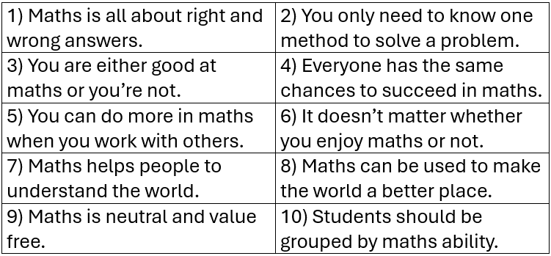
Discourses around school mathematics:
To what extent do you agree with the following statements?
How would you use the statements with students?
What are the implications for your practice?
Notes:
Present the ten statements to participants and ask them to discuss in pairs/small group the extent to which they agree with them [see slide 14].
You might ask:
Which statement do you most strongly agree with? Why?
Which statement do you most strongly disagree with? Why?
Use Appendix 5 (in the facilitators’ notes document), with the statements cut out, to facilitate collaborative working (it helps if the statements can be moved around during discussion).
Take brief feedback from participants on the key points of their discussions.
Some of the statements might be considered ‘discourses’, i.e. statements that are commonly presented as ‘truths’ without questioning whether there is any evidence to support them. They may or may not be considered ‘myths’ (which might depend upon the readers’ differing philosophies of education).
Consider how the statements could be used with students as part of a classroom activity. What would be the purpose of (or justification for) such an activity?

Slide 15
Discussion:
What has social justice got to do with teaching mathematics?
How has your thinking changed since the start of the workshop?
How might you go about addressing social justice in the mathematics classroom?
What constraints might you face?
What opportunities are there?
Notes:
Ask participants to reflect on the same question that was posed during the Introduction and to compare how their thinking has changed [slide 15].
Encourage them to record their responses to the other questions on slide 15 so that they can refer to these after the workshop (once they are back in their professional setting).
Invite some participants to share their thoughts with the whole group (if they wish).

Slide 16
Planning next steps:
What will you try out within your practice?
What actions will you take?
What literature/resources will support you?
What opportunities are there for collaboration?
How will you evaluate your success?
How will you share your findings with others?
Notes:
Encourage participants to generate an action plan for how they will try out ideas from the workshop in developing their own practice [see questions on slide].
Emphasise principles underpinning effective professional development, i.e. prolonged engagement with ideas, critical reflection on existing practice, engaging with theory, relating theories closely to practice, collaboration with colleagues, recognising classroom constraints and opportunities, evaluating the impact on students.

Slide 17
References:
Cotton, T., Jagdev, M. K., Kaur, B. & Wright, P. (2024). Towards a socially just mathematics curriculum. London: Routledge
Wright, P. (2024). The mathematics curriculum and concerns for social justice. In T. Cotton, M. K. Jagdev, B. Kaur, & P. Wright, Towards a socially just mathematics curriculum (pp. 19-31). London: Routledge.
Recommended reading and teaching resources:
The Teaching Mathematics for Social Justice Network website: www.mathsocialjustice.org
Notes:
Flag up the features of the TMSJN website – this is an excellent source of further reading, links to other research projects/websites, classroom activities written by TMSJN members and other recommended resources published by others.

